Slide 1



10 BLACK
ARKANSANS
IN SCIENCE
Notes:
Whether you're a born and raised Arkansan, lived here for 30 plus years, or recently arrived to the Natural State, this place we call home has a rich, diverse, and unique history.
Since the website was launched in the mid-2000s, the staff of the Encyclopedia of Arkansas has tried to make sure that the story of this place is documented in an accessible digital format.
This free resource has almost everything you might want to know about the 25th state. And the EOA staff are in the habit of finding the most fascinating of those stories to tell.

Slide 2

Notes:
The CALS Encyclopedia of Arkansas launched in 2006 with 700 entries and 900 pieces of media.
In 2019 we switched platforms from the original proprietary website to a newly designed WordPress site.
In August 2022 we undertook a further redesign of the home page, search function, and user experience features.
You can stop by the EOA for tidbits like THIS DAY IN ARKANSAS HISTORY and PHOTO OF THE DAY...
As well as trending entries and what's been newly updated. (And here's a hint, we are updating all the time!)

Slide 3
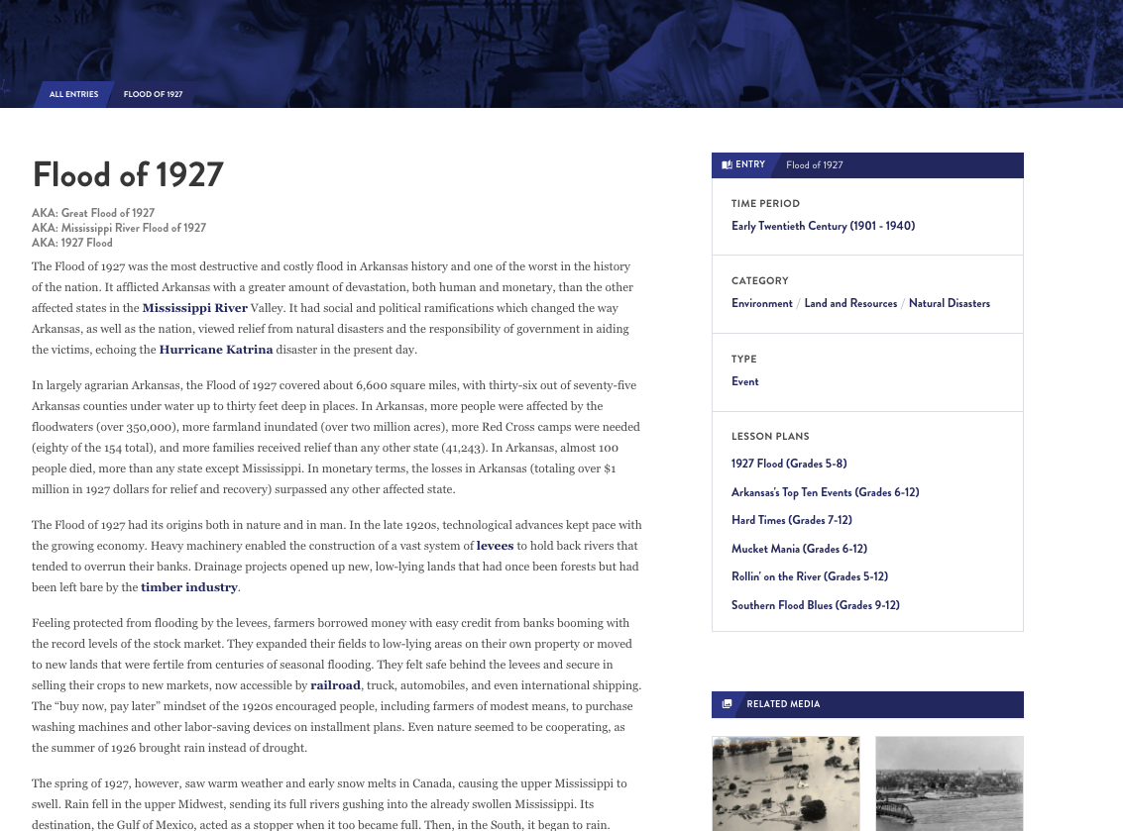
7,000+
entries
Notes:
Over 7,000 entries
Often compared to Wikipedia but with the difference that our entries are peer reviewed and professionally edited
Anyone can write for the EOA but all entries are reviewed by other scholars, fact checked, and edited for grammar and spelling.

Slide 4
  EVERY incorporated community
  Government officials
  Civil rights organizations from NAACP to CLOB
  EVERY military action including the smallest skirmishes
  Wildlife, flowers, plants
Notes:
WE HAVE ENTRIES ON ...
Every incorporated community, hundreds of unincorporated ones and always seeking more
ENTRIES ON
Government officials from those who served in Congress, to Arkansas constitutional officers, to individual state legislators, even significant sheriffs, mayors, and county judges
Civil rights organizations from the national level, such as the NAACP, to the local level, such as CLOB (Council for Liberation of Blacks)
Military events from the Civil War, ranging from major battles (Pea Ridge) down to small local skirmishes; if someone in blue and someone in gray met in the woods between 1861 and 1865 we probably have an entry documenting it.
AND THE NATURAL ENVIRONMENT - birds, fish, mammals but also fungi, lichens, ferns, jellyfishes
AND WE ARE ALWAYS DEVELOPING MORE...
Developing entries on every film set or filmed in Arkansas, as well as every book, television show, and even individual episodes set in the state (Search: X-Files)

Slide 5
Produced by a public library
230 countries
EVERY continent
Notes:
Used by government agencies and officials, students, media, genealogists, historians (local and national)
Users have come from every continent (including Antarctica) and more than 230 countries.
Over 175,000 users per month

Slide 6
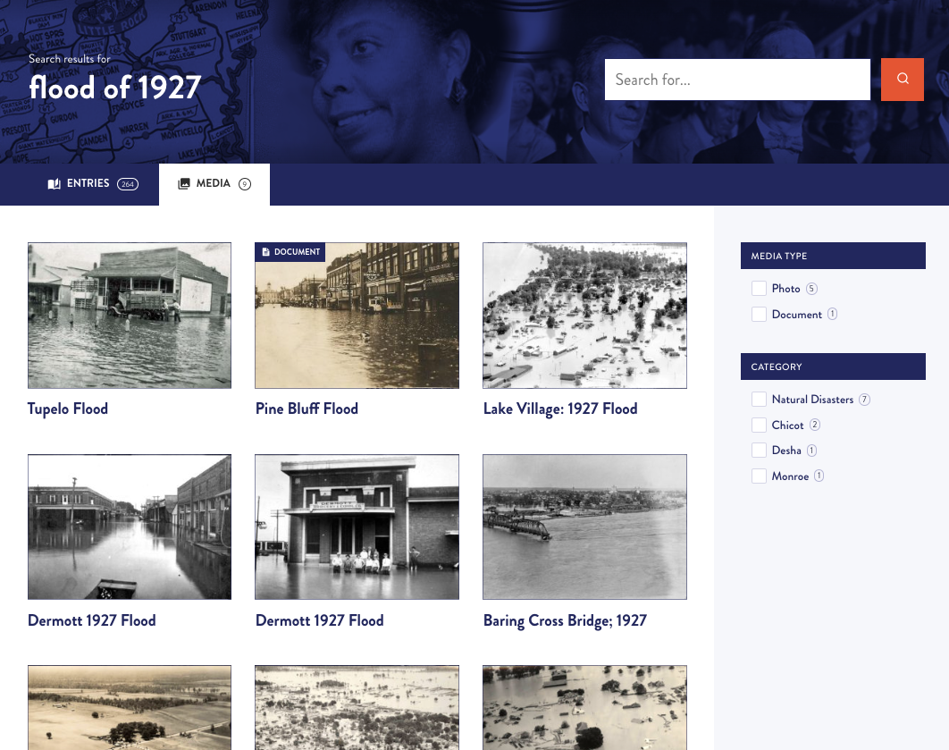
17,000+
media
Notes:
AND DO WE HAVE MEDIA...
We have worked with archives, libraries, museums, and universities around the state and the country to make sure that the EOA has visual images to illustrate our entries.
BUT THERE IS ALWAYS MORE TO FIND...
We rely on everyday citizens to help us locate photos.

Slide 7
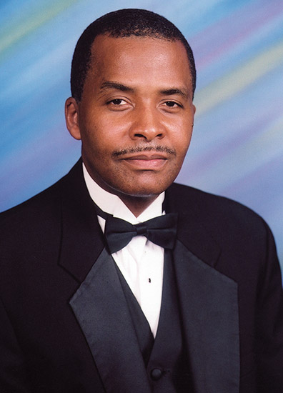

Notes:
Oliver Keith Baker is a Yale University physicist who has conducted groundbreaking research in particle physics and is a nationally known educator for his work on integrating technology into the classroom. He was inducted into the Arkansas Black Hall of Fame in 2006.
Oliver Baker was born on July 18, 1959, in McGehee (Desha County). Baker studied physics at the Massachusetts Institute of Technology. He went on to earn a master’s degrees in physics and mathematics from Stanford University, followed by his PhD in physics. His dissertation covered the topic of the nuclear resonance effect on atomic electron capture by protons. He pursued a post-doctoral fellowship at the Los Alamos National Laboratory after graduation before taking a position as an instructor at North Carolina State University.
Baker was appointed staff scientist at the Thomas Jefferson National Accelerator Facility (commonly called the Jefferson Lab) in Virginia, the Nuclear Science Division Review Committee at the Lawrence Berkeley National Laboratory, and on the Committee of Visitors for the Department of Physics at Harvard University.
Baker was named the Endowed University Professor of Physics at Hampton University. He was named dean of the School of Science and became the founding director for the Center for the Study of the Origin and Structure of Matter (CSOM), a National Science Foundation Physics Frontier Center.
Baker was appointed director of the Yale Wright Laboratory, which houses the world’s most powerful tandem Van de Graaff particle accelerator. Baker was also a researcher on the ATLAS experimental team at the European Organization for Nuclear Research (CERN) in Geneva, Switzerland, playing a role in the discovery of the elusive Higgs boson particle.
Baker serves as a professor of physics at Yale University.

Slide 8
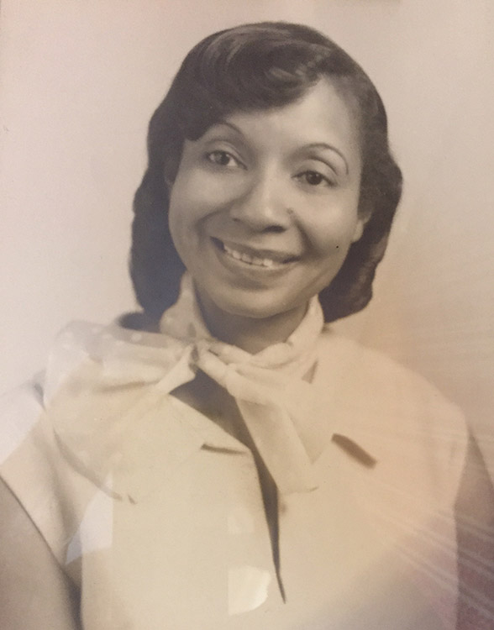

Notes:
Dorothy M. Hoover was a pioneer in the field of aeronautical mathematics and physics. The granddaughter of enslaved people, she overcame the significant obstacles facing African American women in the Jim Crow era of the twentieth century to earn advanced degrees in mathematics and physics. One of her greatest achievements in aeronautical research was her contribution to the development of the “thin sweptback tapered wing,” which revolutionized flight and became the aviation industry standard.
Dorothy Estheryne McFadden was born in Hope (Hempstead County) on July 1, 1918. She graduated from Henry Clay Yerger High School in Hope at the age of fifteen. McFadden attended University of Arkansas at Pine Bluff and graduated with a BS in mathematics.
She married Sylvanus Bowe Clarke. Dorothy Clarke earned her first master’s degree, in mathematics, from Clark Atlanta University.
Clarke was one of the first six African American women hired as P-1 mathematicians at Langley Labs, NACA (later NASA). She worked at Langley for nine years, during which time she achieved several firsts in the field of aeronautical research.
She was listed as co-author on two NACA publications. This was a landmark accomplishment.
She married Richard Allen Hoover. She earned her second master’s degree, in physics, from the University of Arkansas (UA) in Fayetteville (Washington County). She did coursework in a mathematics PhD program in Michigan. Hoover worked in Washington DC. She entered space research, working at NASA’s Goddard Space Flight Center in Greenbelt, Maryland. She worked at the Defense Information System Agency.
The University of Arkansas Hope-Texarkana established the Dorothy McFadden Hoover “Hidden Figure” Memorial Endowed Scholarship. She was also inducted into the Arkansas Women’s Hall of Fame. Hoover died in 2000.

Slide 9
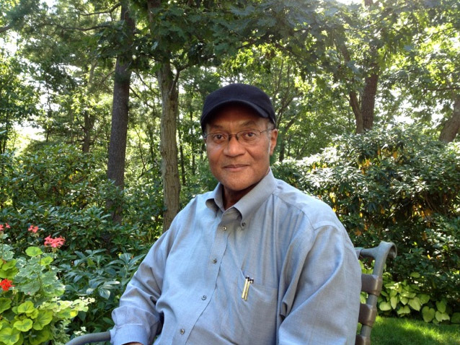

Notes:
Eddie Reed was a cancer researcher, medical oncologist, and leader in public policy addressing disparities in healthcare in the United States. Reed was inducted into the Arkansas Black Hall of Fame.
Eddie Reed was born on December 17, 1953, near Hughes (St. Francis County). Reed attended Philander Smith College, a historically Black institution in Little Rock (Pulaski County).
He was chosen to work in medical research at the National Cancer Institute (NCI) in Maryland. There Reed studied the metabolic disposition of allopurinol, an important medication for treating gout and leukemia. This led to a career in cancer drug development in the nation’s foremost research institutions. After graduation from Philander Smith he completed his medical degree from Yale Medical School and trained in internal medicine at Stanford University Hospitals. He entered the United States Public Health Service, of which the NCI is a part. He became a career officer and scientist in the NCI.
At the NCI, his research focused on the new anticancer drug cisplatin. Reed also remained a committed cancer physician.
He was promoted to chief of the Clinical Pharmacology Branch at the NCI. He retired from the Public Health Service after a twenty-year career to become director of the Mary Babb Randolph Cancer Center at the University of West Virginia.
He was chosen to be director of the Division of Cancer Cause and Prevention of the U.S. Center for Disease Control and Prevention in Georgia, where he led national programs to advance cancer screening and diagnosis. He left to become clinical director of the Mitchell Cancer Center at the University of South Alabama and was chosen to become the first clinical director of the newly formed National Institute of Minority Health and Health Disparities at the National Institutes of Health (NIH) in Maryland, the position he held until he died of cancer.

Slide 10
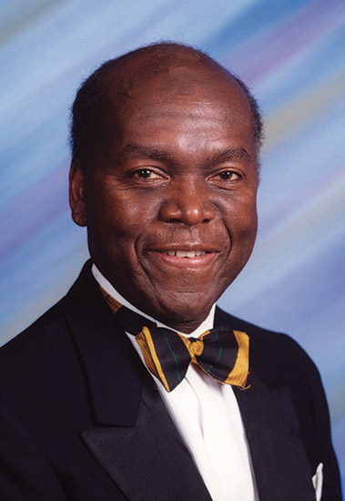

Notes:
David L. Evans worked as an engineer on the Saturn rockets and Apollo moon landing missions but became best known for his recruitment efforts on behalf of Harvard University, where his work led to greater diversity in the student body. He was inducted into the Arkansas Black Hall of Fame.
David L. Evans was born in 1939 in Wabash (Phillips County). He originally wanted to pursue creative writing in college but realized he needed to contribute to supporting his family. His talents in math and science led him to enroll at Tennessee State University, a historically Black institution, and he received an electrical engineering degree. After graduation, he worked for Boeing and Lockheed. Evans enrolled at Princeton University and pursued a PhD. He ended his study early and instead earned a master’s degree in electrical engineering.
Evans returned to the South to work for the National Aeronautics and Space Administration (NASA) in Huntsville, Alabama. He served as an aerospace scientist in quality control for IBM’s Federal Systems Division for the Saturn rockets and Apollo moon landing missions.
Evans was present during the integration of Huntsville’s schools and sought to address the high drop-out rate of Black students. He began an unpaid, one-man recruitment and tutoring service for Black students seeking higher education. He reached out to roughly 100 colleges around the country.
During his first year of recruitment, Evans successfully recruited five students to Princeton, Brandeis University, Smith College, and Washington State University.
With local media attention, Evans received job offers from Harvard, the College Entrance Examination Board, and Massachusetts Institute of Technology (MIT).
Evans took a leave-of-absence in engineering to join the faculty and staff in the Harvard Admissions Office. He came to consider his recruitment work more influential on society, and left engineering for education permanently.

Slide 11
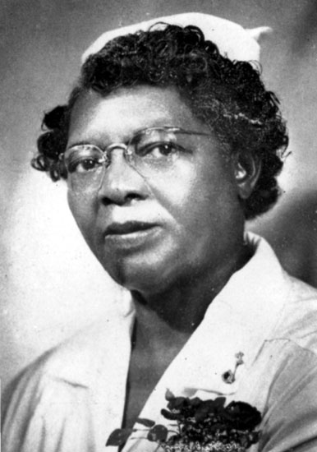

Notes:
Lena Lowe Jordan was an African American registered nurse and hospital administrator who managed two institutions for African Americans—a hospital for the care of disabled children which became a general hospital. In addition, she began a unique training program for young Black women who wanted to become practical nurses.
Lena Lowe was born on April 6, 1884, in Georgia. She trained as a nurse at the Charity Hospital of Savannah.
She moved to Little Rock (Pulaski County) and began her career as a registered nurse in Arkansas as head nurse at the Mosaic State Hospital. She married Peach Jordan.
Jordan was affiliated with the Arkansas Home and Hospital for Crippled Negro Children in Little Rock. She placed an article in the Arkansas Gazette for funds to save the institution, explaining it was the only charity hospital for Black “crippled” children in the state. She placed a mortgage on her own home to obtain funds to operate it. The date the institution became a general hospital for Blacks is unclear, but it was named the Lena Jordan Hospital while she still lived.
The Lena Jordan Hospital was a twenty-bed hospital equipped for general surgery, medical, and obstetric care. It was open to all Black patients, regardless of their ability to pay.
Jordan began an innovative program of training nurses for the hospital. She provided an opportunity for young women to work at the hospital and obtain a practical nurse’s certificate for their work. She provided room and board, clothes, and a salary. She cooperated with the Red Cross in providing a Home Nursing class. Jordan was the instructor, and ninety-one Black women earned certificates.
A program was held at the hospital on National Hospital Day honoring Jordan on the fortieth anniversary of her nursing career. The event coincided with the twenty-first anniversary of the institution. Jordan spent thirty years of her career in Little Rock, providing care for the underserved Black community. She died in 1950.

Slide 12
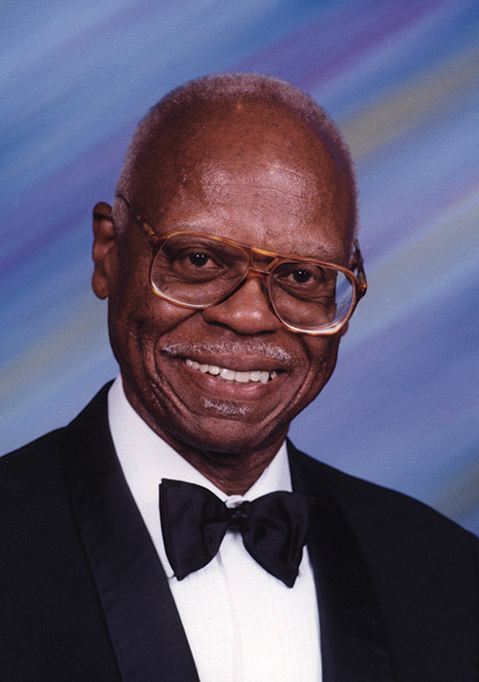

Notes:
Ernest James Harris was an accomplished entomologist known for his work on breeding Biosteres arisanus, a species of wasp that parasitizes fruit fly eggs. Thanks to the work done by Harris, B. arisanus has been bred on a large scale for the purposes of pest eradication and more than twenty nations have adopted use of the “Harris strain” for fruit fly eradication. Harris was inducted into the Arkansas Black Hall of Fame.
Ernest J. Harris was born on May 24, 1928. His parents had a farm in North Little Rock (Pulaski County), where Harris’s interest in insects first developed. He attended the University of Arkansas at Pine Bluff. He majored in chemistry, with a minor in zoology.
Harris moved to Minnesota to take a position with the forest service. While there, he studied for his master’s degree in entomology at the University of Minnesota. After graduation, he returned to Pine Bluff (Jefferson County) to teach science but left to take a job with the United States Department of Agriculture (USDA) in Hawaii. At the University of Hawaii, he obtained his PhD in entomology.
During more than forty years with the USDA, Harris served in a number of research and leadership capacities in his field. However, he is most well known for his research on the control of fruit flies, a common pest that damages and destroys fruit crops.
Harris received an official commendation from the Chilean government. He has been the recipient of several other honors, including induction into the Royal Entomological Society of London. He is a member of the Hawaiian Entomological Society, the Entomological Society of America, the International Organization of Biological Control, and the African Association of Insect Scientists, among others. He published more than 100 peer-reviewed articles in a variety of scientific journals.
Harris received the NAACP Lifetime Achievement Award for Distinguished Service. He died in 2018.

Slide 13
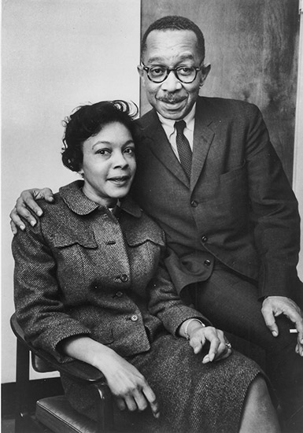

Notes:
Mamie Katherine Phipps Clark was the first African American woman to earn a PhD in psychology from Columbia University. The research she did with her husband was important in the success of the 1954 case Brown v. Board of Education of Topeka, Kansas, in which the U.S. Supreme Court declared the segregation doctrine of “separate but equal” to be unconstitutional.
Mamie Phipps was born on October 18, 1917, in Hot Springs. Phipps attended segregated public schools.
She attended Howard University. There she met Kenneth Clark and they eloped. She received her BA in psychology and earned a graduate fellowship to enter Howard’s master’s degree program in psychology.
Working on her thesis, Clark found that Black children “became aware of their racial identity at about age three, and—simultaneously with their awareness of racial identity—acquired a negative self image.” This pioneering “research into the importance of self in Black children... paved the way for an increase in psychological research into... self-esteem and self-concept.”
Her research is regarded as an important step in opening areas of inquiry in the evolution of developmental psychology.
Clark obtained her PhD in psychology from Columbia University. She was the only Black student in the department.
She took a position as psychologist with the Riverdale Home for Children, “a private agency for the protection of Black, homeless girls.”
Unable to persuade directors of social agencies serving Harlem to provide psychological services for children, Clark and her husband opened the Northside Center for Child Development.
The center was the first full-time institution in the Harlem area that offered psychological and casework services to local families. Clark served as executive director.
Clark served on many boards and advisory groups.
Clark's work ushered in new approaches to treatment and remains a landmark in the history of psychology. She died in 1983.

Slide 14
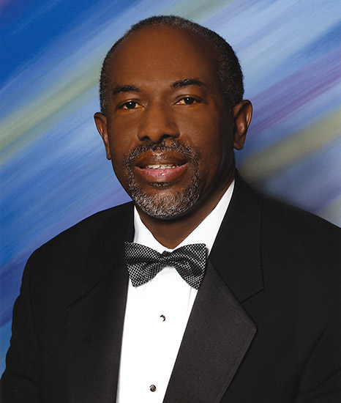

Notes:
James Earl King Hildreth, a leading HIV/AIDS researcher, is dean of University of California–Davis College of Biological Sciences.
He has served as director for the Center for AIDS Health Disparities Research; program director of the Research Centers in Minority Institutions; associate director at the Vanderbilt-Meharry Center for AIDS Research; and professor of internal medicine, microbiology, and immunology.
At the Center for AIDS Health Disparities Research, he worked on a cream that kills the human immunodeficiency virus (HIV).
James Earl Hildreth was born in Camden (Ouachita County) on December 27, 1956.
Hildreth graduated from Harvard with a degree in chemistry. He then went to Oxford University in England as a Rhodes scholar. Hildreth was the first African-American Rhodes scholar from Arkansas.
He married Phyllis King and added King to his name to honor her.
Hildreth earned his doctorate in immunology. He returned to the United States to attend Johns Hopkins University School of Medicine where he earned a medical degree. He taught at Johns Hopkins and was an associate dean.
Hildreth’s research focuses on HIV and AIDS. HIV is a virus that attacks the cells of the immune system and leads to AIDS, or acquired immune deficiency syndrome. About fifty percent of the people infected with HIV in the United States live in the South. African Americans make up less than fourteen percent of the population of the United States but make up forty-five percent of new HIV infections in the country.
He was given a grant from the federal Centers for Disease Control and Prevention (CDC) to partner with Black churches for the purpose of educating people about HIV.
Hildreth traveled to Zambia and South Africa to test his HIV-killing cream with the goal of helping developing countries lower their HIV infection rates.
He has also written and co-written many publications and has received many awards and honors, including induction into the Arkansas Black Hall of Fame.

Slide 15
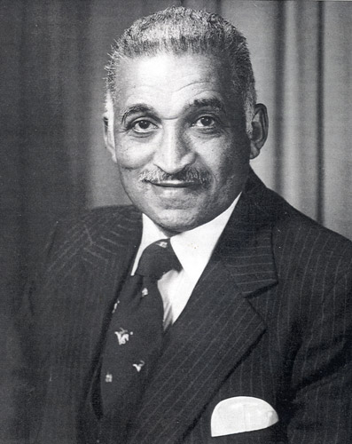


Notes:
Samuel Proctor Massie Jr. overcame racial barriers to become one of America’s greatest chemists in research and teaching. As a doctoral candidate during World War II, he worked on the Manhattan Project in the development of uranium isotopes for the atomic bomb. Massie’s research over fifty years led to the development of drugs to treat mental illness, malaria, meningitis, gonorrhea, herpes, and cancer.
Chemical and Engineering News named him one of the top seventy-five chemists of all time, along with Marie Curie, George Washington Carver, and DNA pioneers Watson and Crick.
Samuel Massie was born on July 3, 1919 in North Little Rock (Pulaski County). He started at Dunbar High School in Little Rock (Pulaski County) at age thirteen.
He earned a bachelor’s degree in chemistry with a minor in mathematics at the University of Arkansas at Pine Bluff) and finished a master’s degree in chemistry at Fisk University.
Massie received his PhD in organic chemistry at Iowa State.
Massie married Gloria Bell Thompkins. Massie taught at various colleges and universities.
In 1954, he published “The Chemistry of Phenothiazine,” an article in Chemical Review that led to a breakthrough by French chemists in development of the anti-psychotic drug Thorazine.
The Manufacturing Chemists Association recognized Massie as one of the six best chemistry teachers in America.
He served as president of North Carolina College and was then appointed as professor of chemistry at the U.S. Naval Academy in Maryland, where he was the first Black faculty member.
During his tenure there, Massie served on the academy’s equal employment opportunity committee and helped establish a Black studies program. His portrait was hung in the National Academy of Sciences Gallery.
The U.S. Department of Energy created the Dr. Samuel P. Massie Chair of Excellence, a $14.7 million grant to nine historically Black colleges and one for Hispanic students to further environmental research.
He did in 2005.

Slide 16
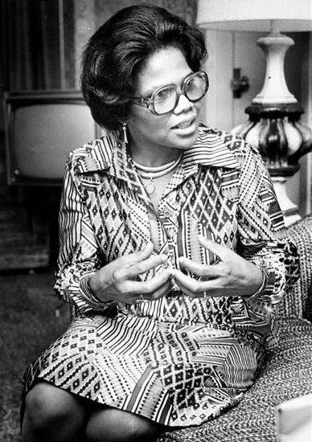
Notes:
Edith Irby Jones was the first African American to attend and graduate from the University of Arkansas for Medical Sciences (UAMS) in Little Rock (Pulaski County). She was a pioneer in the desegregation of higher education in Arkansas and the South and served as a highly successful doctor, educator, and philanthropist in Arkansas, Texas, and overseas.
Edith Irby was born on December 23, 1927. She lived near Conway (Faulkner County) and in Hot Springs (Garland County).
At Knoxville College Irby majored in chemistry, biology, and physics. Irby became the first African American accepted at UAMS—as well as the first accepted at any medical school in the South. This accomplishment was reported nationally in many publications, including Life, Time, Ebony, and the Washington Post.
She married Dr. James B. Jones. She received her MD degree. She opened a general practice in Hot Springs.
Jones interned at Baylor College in Texas. She completed her residency at Freedman’s Hospital in Washington DC.
She was among several Black physicians who founded Mercy Hospital and one of twelve doctors who owned and developed Park Plaza Hospital. Over time, she accumulated staff privileges at nine Houston-area hospitals, including the Houston Hospital, which was renamed the Edith Irby Jones M.D. Health Care Center in her honor.
She was elected the first female president of the National Medical Association (NMA). She was the only female founding member of the Association of Black Cardiologists (ABC). Jones taught, consulted, and/or provided healthcare in not only in the United States but also in Haiti, Mexico, Cuba, China, Russia, and throughout Africa. She provided support for two international healthcare locations that bear her name: the Dr. Edith Irby Jones Clinic in Vaudreuil, Haiti (which she helped to build), and the Dr. Edith Irby Jones Emergency Clinic in Veracruz, Mexico.
Jones was a charter member of Physicians for Human Rights, which won the Nobel Peace Prize. She died in 2019.

Slide 17

QUESTIONS
Notes:
This is just the tip of the iceberg. The CALS Encyclopedia of Arkansas is a rabbit hole I encourage you to jump down. No matter what you are interested in, Arkansas has it—and the EOA is where you can start looking.

