Slide 1
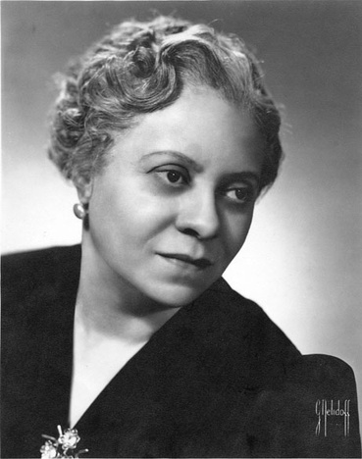


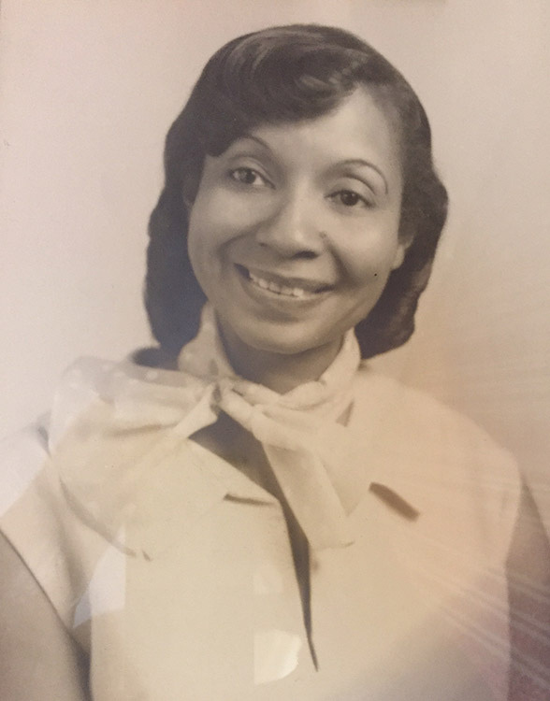
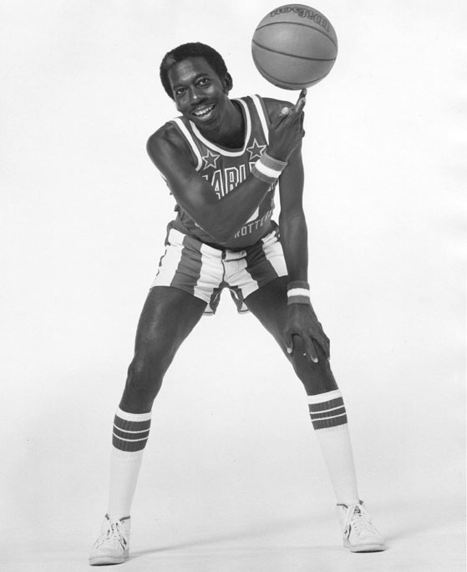
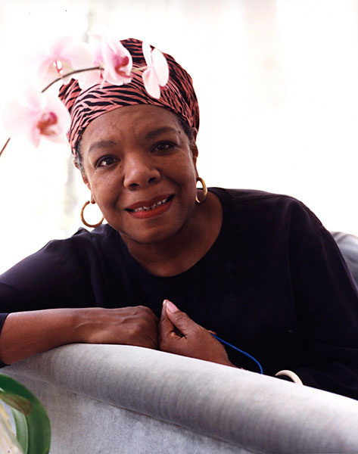
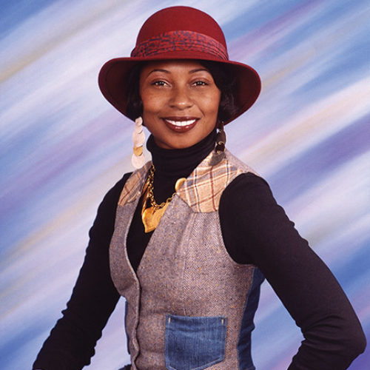
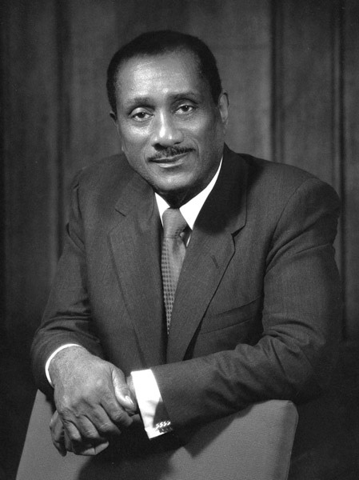
How Black Arkansans
Have Changed the World

Slide 2
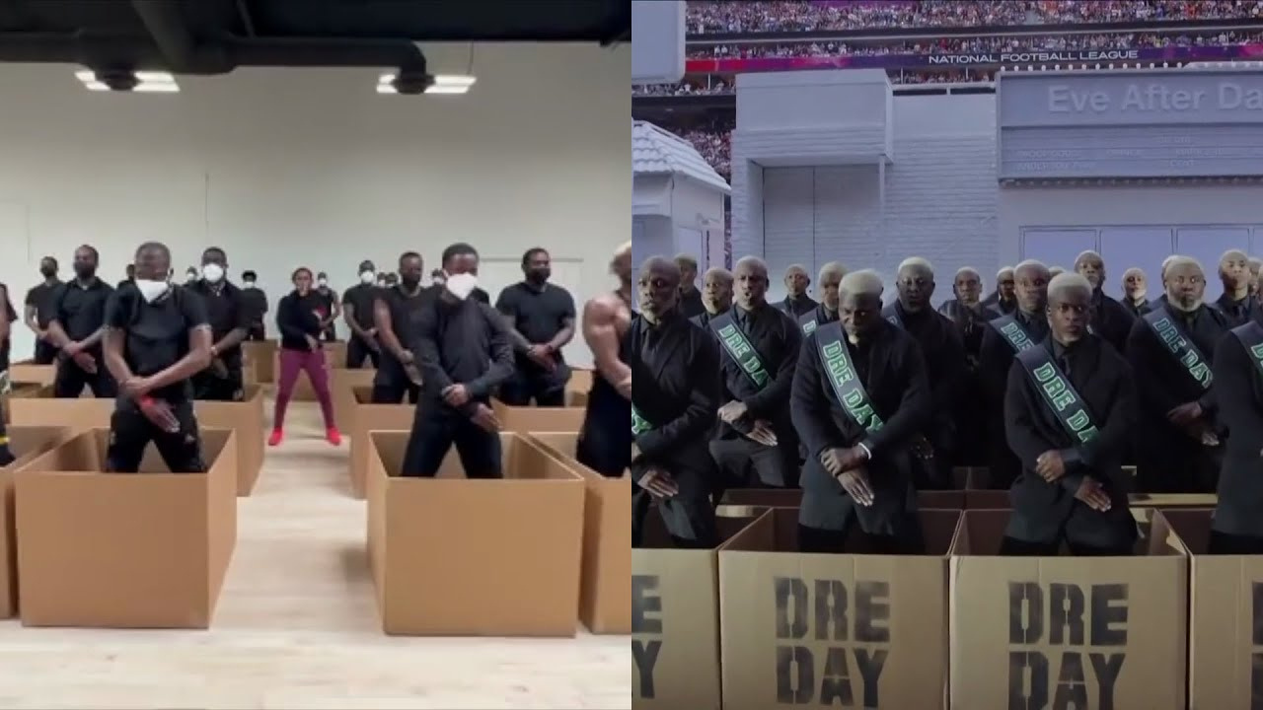
Notes:
Who likes to dance or takes dance classes?
Does anyone remember the 2022 Super Bowl Halftime Show. It's the one that featured Dr. Dre, Snoop Dogg, Eminem, Mary J. Blige, and Kendrick Lamar.
The dances in that show were choreographed by an Arkansan.

Slide 3

Notes:
Fatima Robinson was born here in Little Rock in 1971 and moved to Los Angeles at age four with her family.
Robinson worked in her mother's hair salon after high school, but she dreamed of dancing professionally. Her big break came in 1992 when director John Singleton asked her to choreograph the dance sequences for Michael Jackson's new music video for the song "Remember the Time."
This project launched her career, and she was soon choreographing for other music videos and television programs. She worked on the movie biopic about Muhammad Ali, the TV movie Their Eyes Are Watching God, and the NAACP Image Awards. She also choreographed commericials for Pepsi, Gap, and Verizon. And most recently she choreographed the new movie musical The Color Purple.

Slide 4
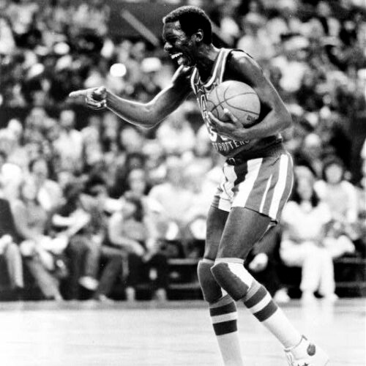
Notes:
Who plays basketball?
Have you seen the Harlem Globetrotters play?
Arkansan Hubert "Geese" Ausbie joined the Globetrotters in 1961 after a standout college basketball career at Philander Smith College in Little Rock (now Philander Smith University).
Known as the Clown Prince of Basketball, he turned down a professional baseball contract with the Chicago Cubs and signed to play basketball with the Globetrotters instead of the LA Lakers and the Cincinnati Royals.
During his career with the Globetrotters, Ausbie appeared on ABC's Wide World of Sports, the Globetrotters' Saturday morning cartoon show, and other entertainment specials.
Ausbie was inducted into the Arkansas Sports Hall of Fame in 1990 and the Arkansas Black Hall of Fame in 1995.

Slide 5

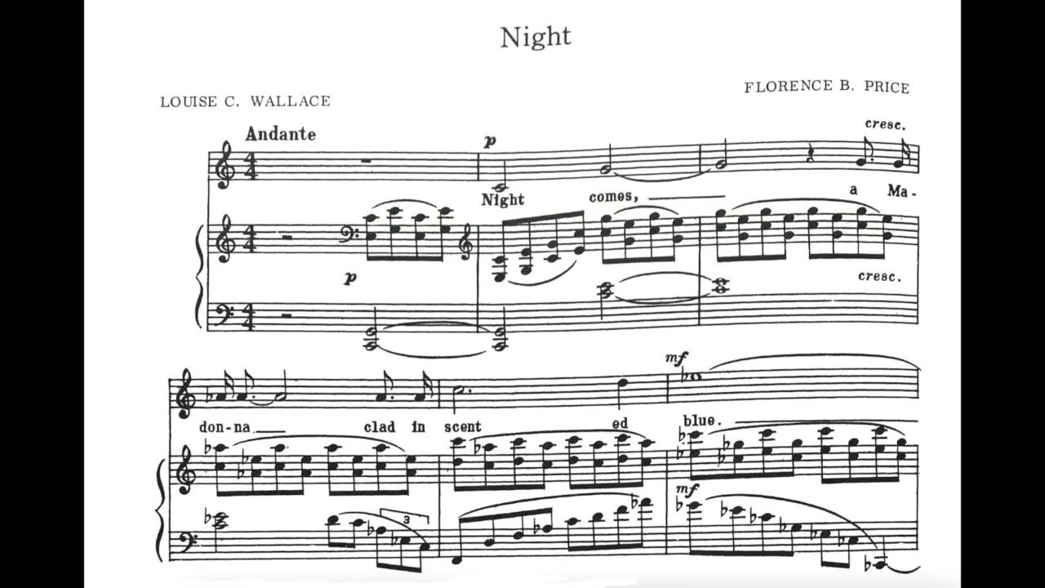
Notes:
Anyone a singer or other kind of musician?
Little Rock native Florence Price was the first African American woman to have a symphonic composition performed by a major American symphony orchestra.
Born in Little Rock in 1887, Price was taught to play the piano by her mother, who was a music teacher. She attended the New England Conservatory of Music in Boston, Massachusetts, and graduated in 1906 with degrees in organ and piano instruction.
She returned to Arkansas after graduation and taught at Cotton Plant Academy and later at Shorter College in North Little Rock. She was denied membership into the Arkansas State Music Teachers Association because of her race.
Worsening racial tension in Arkansas in the 1920s forced the Prices to move to Chicago in 1927. Price's music composing career flourished in Chicago. In 1928 her composition At the Cotton Gin was published, and then in 1932 she won competitions with her Piano Sonata in E Minor and her Symphony in E Minor.
Price's compositions mixed classical European music and the sounds of Black spirituals such as juba dance.
She died in 1953 and has been inducted into the Arkansas Women's Hall of Fame and the Arkansas Black Hall of Fame.

Slide 6

Notes:
Has anyone read I Know Why the Caged Bird Sings?
Author Maya Angelou was born in St Louis, Missouri, in 1928. After her parents' divorce, Maya and her brother Bailey were sent to live with their paternal grandmother, Annie Henderson, in Stamps, Arkansas. Angleou's experiences in this small Arkansas town formed the setting for the autobiographical book I Know Why The Caged Bird Sings.
Angelou attended high school in San Francisco. She graduated at age 16 and gave birth to her son three weeks after graduation. She worked as a cable car conductor, a cocktail waitress, a dancer, and a cook -- all before the age of 25. These life experiences would inspire her writing.
In 1954, she toured Europe and Africa with a stage production of Porgy and Bess and then in 1955 moved to NYC where she studied dance. She played a key role in fundraising for the Southern Christian Leadership Conference and was appointed by Dr. Martin Luther King, Jr. to be their northern coordinator.
In the 1960s she lived in Egypt and Ghana, working for the weekly newspapers Arab Observer and African Review. She met Malcolm X while in Ghana.
The assassinations of Malcolm X and Martin Luther King Jr., along with encouragement from novelist James Baldwin, prompted Angelou to begin writing the first installment of her life story. I Know Why the Caged Bird Sings was published in 1970 and has been translated into more than 10 languages.
In 2000 she was awarded the National Medal of Arts and in 2011 President Obama awarded her the Presidential Medal of Freedom. Angelou died in 2014. Stamps, Arkansas, named its only park after her and in 2015 the United States Postal Service released a stamp in her honor.

Slide 7
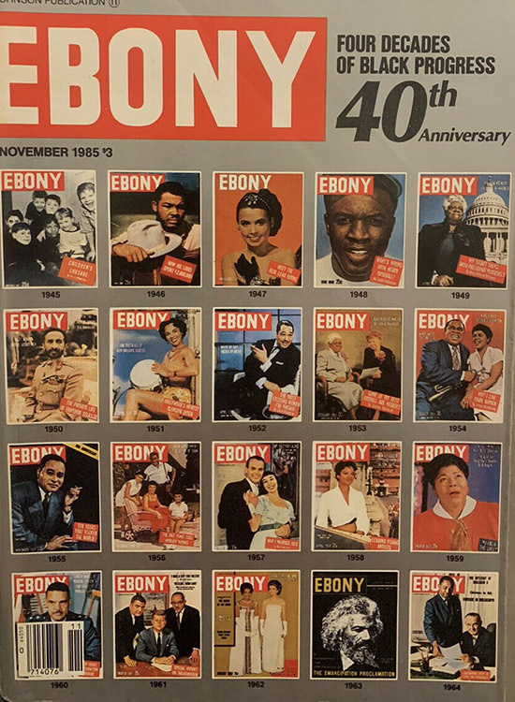
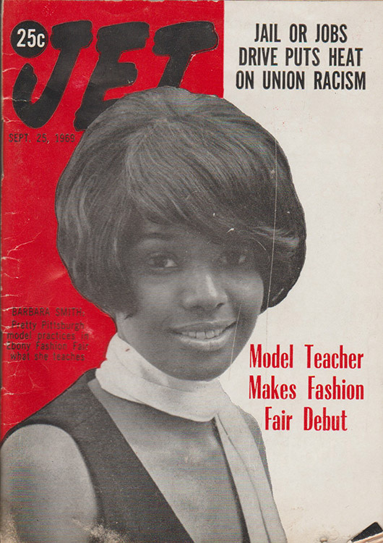
Notes:
Anyone know Ebony and Jet magazines?
John H. Johnson created Johnson Publishing Company, the largest Black-owned and -operated publishing company in the world. Johnson was born in Arkansas City, Arkansas, and moved to Chicago to attend high school because African Americans were unable to get an education after the eighth grade in Arkansas City.
He worked part-time at an insurance company while attending classes at the University of Chicago. In 1942 Johnson took out a loan for $500 to start Negro Digest. This led to the creation of Johnson Publishing, and he created Ebony in 1945 and Jet in 1951.
Ebony became the #1 African-American magazine in the world, with 2.5 million monthly readers at one time. It emphasizes positive aspects of Black life in America and provides inspiration to all African Americans. Jet became the #1 newsweekly magazine, with more than 9 million subscribers. It provides coverage of current news as well as reports on events or individuals. The influence of Ebony and Jet, which are now digital publications, was immediate and widespread as articles covered Black history, culture, and demand for equality in American life.
Johnson died in 2005. The United States Postal Service released a stamp in his honor in 2012.

Slide 8

Notes:
Whose favorite class is science?
Who's seen the movie Hidden Figures?
Did you know Arkansas has its own Hidden Figure who helped America win the space race?
Dorothy McFadden Hoover was a pioneer in math and physics including developing the "thin sweptback tapered wing" which revolutionized flight and became the aviation industry standard.
Born in Hope, Arkansas, Hoover graduated from Yerger High School in 1934 and attended Arkansas Agricultural, Mechanical, and Normal College (now UAPB), earning a Bachelor's of Science in Mathematics in 1938. She taught school before earning a Master's Degree from Atlanta University in 1943. As a result of President Franklin D. Roosevelt's prohibition of racial discrimination in the national defense industry, Hoover was hired as one of the first African American female mathematicians to work for the National Advisory Committee for Aeronautics (what we now know as NASA).
Over the next 20 years, Hoover would work on a variety of projects but it was her "thin sweptback tapered wing" design that allowed for stable flight at higher speeds. She earned a second Master's degree and a PhD. In 1959 she started working at NASA's Goddard Space Flight Center.
Hoover died in 2000. She was inducted into the Arkansas Women's Hall of Fame in 2023.

