Slide 1



FACTS FOR JUNE, AKA
PRIDE MONTH
Notes:
Did you know that the CALS EOA has many entries on LGBTQ+ issues, celebrities, laws, books, and more?

Slide 2
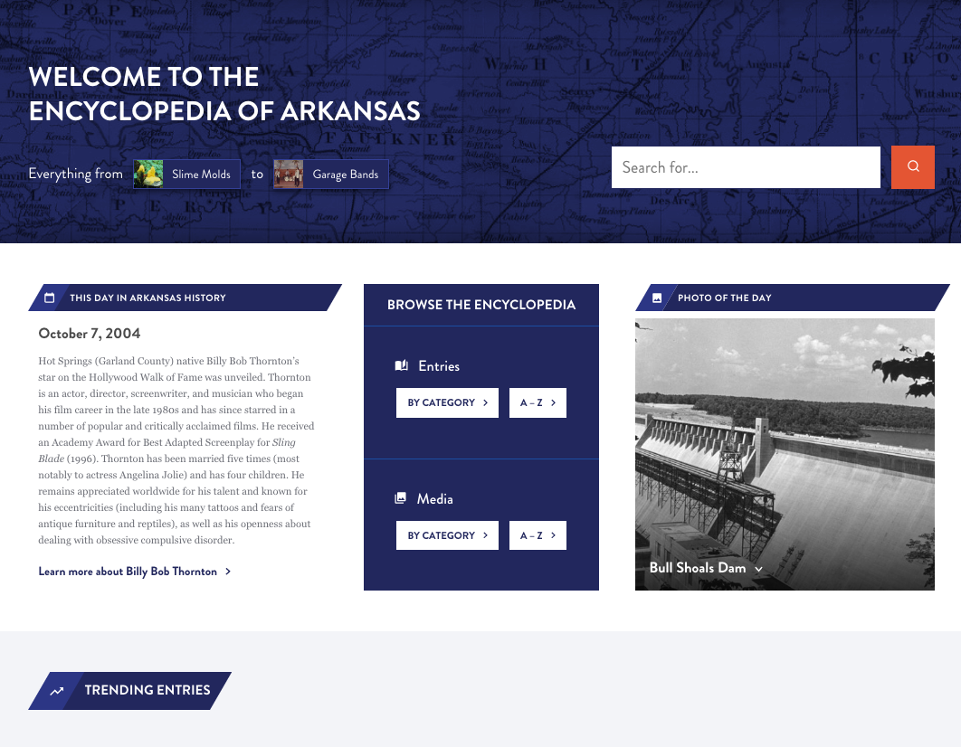
Notes:
The Encyclopedia of Arkansas launched in 2006 with 700 entries and 900 pieces of media.
In 2019 we switched platforms from the original proprietary site to a newly designed WordPress site.
And then in August 2022 we undertook a further redesign of the homepage, search function, and user experience features.
You can stop by the EOA for tidbits like THIS DAY IN ARKANSAS HISTORY and PHOTO OF THE DAY...
As well as trending entries and or to see what's been newly updated. (and here's a hint, we are updating all the time)

Slide 3
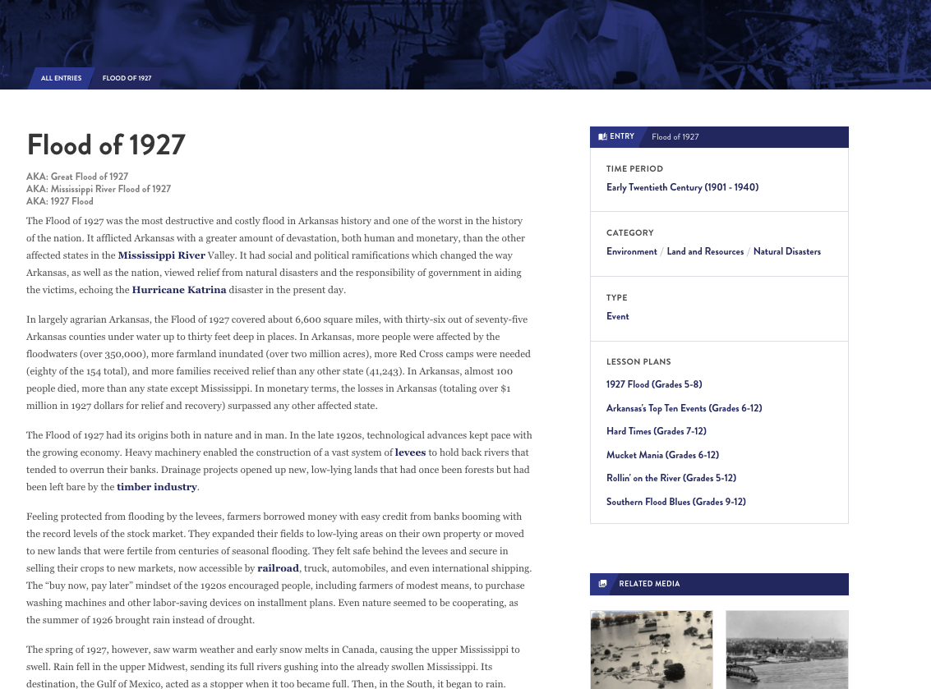
7,000+
entries
Notes:
Over 7,000 entries
Often compared to Wikipedia but is not crowd-edited
Peer reviewed and staff edited entries
Anyone can write for the EOA but all entries are reviewed by other scholars, fact checked, and edited for grammar and spelling.

Slide 4
  EVERY incorporated community
  Government officials
  Civil rights organizations from NAACP to CLOB
  EVERY military action including the smallest skirmishes
  Wildlife, flowers, plants
Notes:
WE HAVE ENTRIES ON ...
Every incorporated community and hundreds of unincorporated ones, and are always seeking more
ENTRIES ON
Government officials, from those who served in Congress, to Arkansas constitutional officers, to individual state legislators, and even significant sheriffs, mayors, and county judges
Civil rights organizations from the national level, such as the NAACP, to the local level, such as CLOB (Council for Liberation of Blacks)
Military events from the Civil War, ranging from major battles (Pea Ridge) down to small local skirmishes; if someone in blue and someone in gray met in the woods between 1861 and 1865 we probably have an entry documenting it.
AND THE NATURAL ENVIRONMENT - birds, fish, mammals but also fungi, lichens, ferns, jellyfishes
AND WE ARE ALWAYS DEVELOPING MORE...
Developing entries on every film set or filmed in Arkansas, as well as every book, television show, and even individual episodes set in the state (Search: X-Files)

Slide 5
Produced by a public library
Users in 230 countries
EVERY continent
Notes:
We are unique in that we are produced by a public library
Used by government agencies and officials, students, media, genealogists, historians (local and national)
Users have come from every continent (including Antarctica) and more than 230 countries.
Over 175,000 users per month

Slide 6
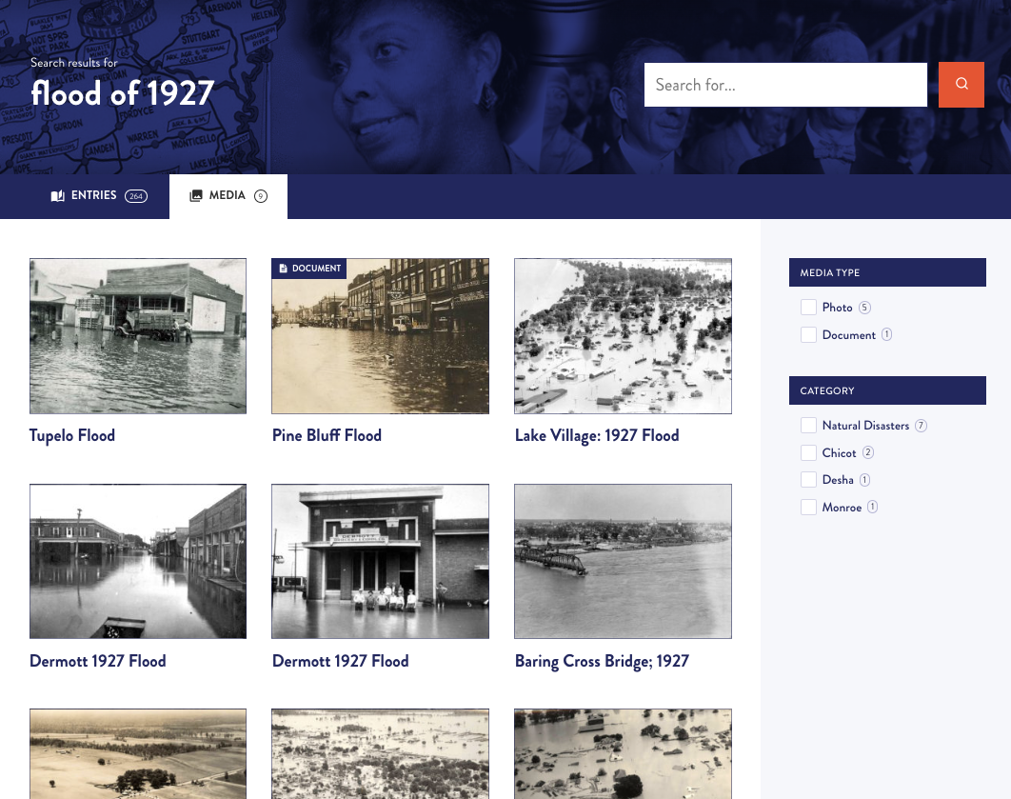
14,000+
media
Notes:
AND DO WE HAVE MEDIA...
We have worked with archives, libraries, museums, and universities around the state and the country to make sure that the EOA has visual images to illustrate our entries.
BUT THERE IS ALWAYS MORE TO FIND...
We rely on everyday citizens to help us locate photos.

Slide 7
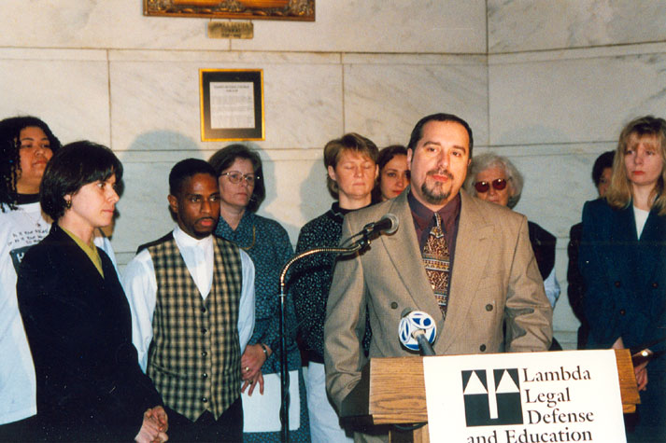

Notes:
Let's dive into some LGBT facts.
Fact 1
LGBTQ+ Movement
If you want to learn more about the LGBTQ+ experience in Arkansas, a great place to start is our overview entry.
The social movement in Arkansas in support of rights for LGBTQ+ people (an umbrella term that covers lesbian, gay, bisexual, transgender, queer/questioning, and more; LGBT was also used in the past) has historically been represented by such legal organizations as Gay and Lesbian Alliance Against Defamation (GLAAD), Lambda Legal, and the American Civil Liberties Union (ACLU). This was followed by an increasing organization of LGBTQ+ people in Arkansas, primarily in the emergence of student groups at the University of Arkansas (UA) in Fayetteville (Washington County) and other institutions of higher education. Despite statewide and nationwide strides toward equality under the law, LGBTQ+ Arkansans still face ongoing discrimination—and the fight for rights, safety, and acceptance is far from over.
This is a photo of Randy McCain at a press conference at the Arkansas State Capitol, during which the Lambda Legal Defense and Education Fund announced its lawsuit against the state’s sodomy law; January 1998.

Slide 8
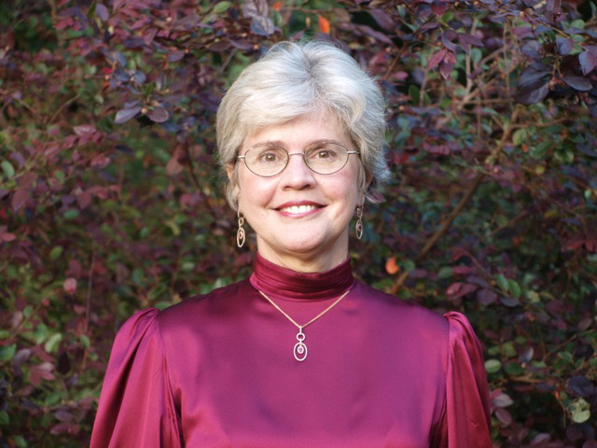

Notes:
Fact 2
Jegley v. Picado
Larry Jegley v. Elena Picado, et al. was a 2002 decision by the Arkansas Supreme Court that struck down Arkansas’s sodomy law, which criminalized homosexual behavior. It was the first time that the Supreme Court removed a legal prohibition against homosexual relationships, and the decision was cited many times in the next dozen years by state and federal courts in several states that invalidated such laws.
Sodomy laws preceded American independence. The colonies criminalized homosexual acts, which were often death-penalty offenses. Sodomy was a felony in every state until 1962, when states began to liberalize the laws.
This is a photo of Annabelle Clinton Imber Tuck, the first woman elected justice of the Arkansas Supreme Court.
The U.S. Supreme Court had found in 1986 (Bowers v. Hardwick) that state laws making homosexuality a crime did not violate those guarantees in the federal Constitution. Justice Annabelle Imber wrote the 2002 majority opinion striking down the statute; her opinion was widely praised for its clarity and thoroughness.

Slide 9
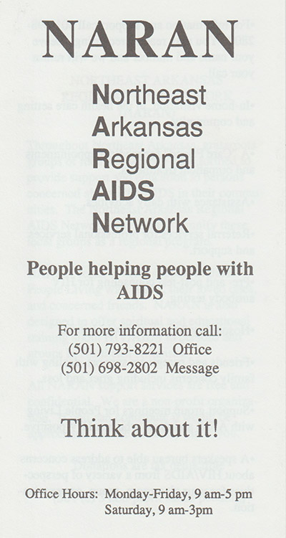

Notes:
Fact 3
The AIDS Crisis and Backlash
This is a picture of the cover of a Northeast Arkansas Regional AIDS Network membership brochure.
The first cases of AIDS in the United States were identified by clinical investigators in New York and California in 1981. By 1984, researchers were able to identify HIV as the cause of full-blown AIDS. In 1983, a Little Rock man in his early twenties became the first Arkansan to die of AIDS-related pneumonia. Because little was known about HIV and AIDS in the early days of the disease, public reaction to the epidemic included discrimination and stigma against the populations who were at risk for the disease—namely bisexual and homosexual men. In Arkansas, the gay rights movement suffered a major setback in the mid-1980s largely due to the emergence of HIV and AIDS.
By 2007, a cumulative 4,119 Arkansans had been diagnosed with Acquired Immunodeficiency Syndrome (AIDS), the disease caused by the Human Immunodeficiency Virus (HIV), with 196 of those cases being newly diagnosed that year. Of all cases diagnosed in Arkansas, more than eighty percent were among men, fifty-seven percent were among whites, and forty percent were among African Americans.
Of those 4,119 diagnosed with AIDS, more than 2,000 were people living with AIDS at the end of 2007. A total of 1,834 people with AIDS in Arkansas had died by the end of 2007. The majority (fifty-three percent) of AIDS cases in Arkansas were most likely transmitted through male-to-male sexual conduct. Other methods of transmission that presented themselves among a large number of those cases were heterosexual contact and injection drug use.

Slide 10
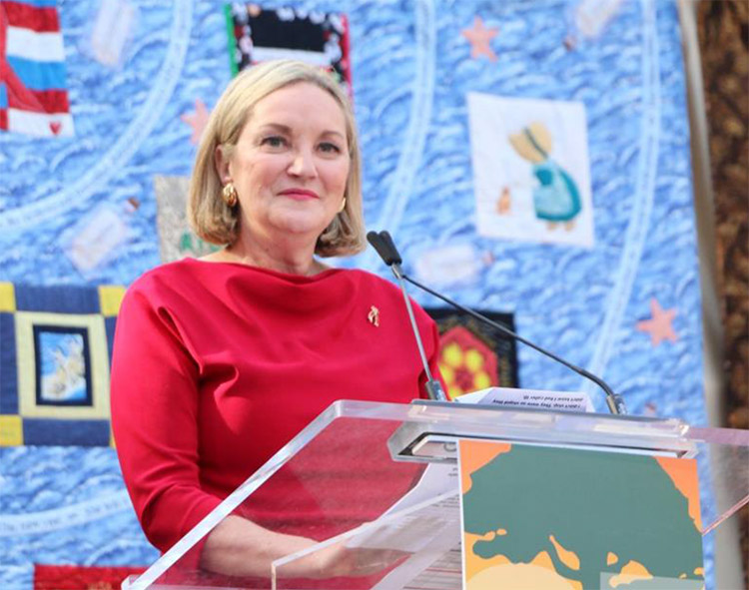

Notes:
Fact 4
Ruth Coker Burks (1959–)
This is a photo of Ruth Coker Burks. Burks is an Arkansas woman who, in the midst of the 1980s AIDS epidemic, provided support for dozens of men who were dying of AIDS—men who were often abandoned by their families, with even some health professionals being reluctant to treat them.
As Burks recalled, she entered the room of a dying AIDS patient. She spoke with the patient, and after he asked for his mother, Burks went to the nurses and conveyed his request. They dismissed it, saying that his mother would not come, introducing Burks to the family abandonment that was so often a part of the dying men’s experiences.
As word of her efforts—the willingness to engage with dying patients, the calls to families on their behalf—spread, she became the go-to person in Arkansas for the care and comfort of dying AIDS patients. She was known as the AIDS Angel and the Cemetery Angel.
When Bill Clinton was elected president, Burks served as a White House consultant on AIDS education. Burks suffered a stroke in 2010 but she remained an outspoken advocate for better understanding of HIV and AIDS.
Her reputation was tarnished when a GoFundMe campaign--intended to create a memorial at Files Cemetery for the gay men who died--resulted in no memorial. Burks admitted to spending some of the money on her own medical expenses.

Slide 11
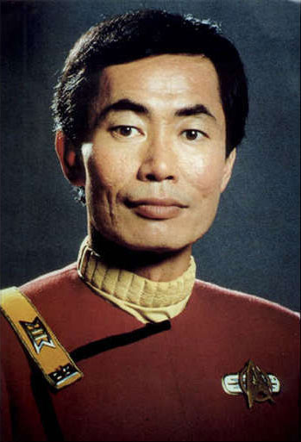

Notes:
Fact 5
George Takei (1937–)
George Hosato Takei, who was held in an Arkansas internment camp at Rohwer as a boy during WWII, gained international fame as Lieutenant Sulu in the original Star Trek television series and movies.
In 2005, Takei announced that he is gay and had been with his partner, Brad Altman, for eighteen years. In 2008, he and Altman were married in the wake of the California Supreme Court’s ruling legalizing same-sex marriages.
An outspoken proponent of gay rights, Takei received the Equality Award from the Human Rights Campaign in 2007 and the American Humanist Association’s LGBT Humanist Award in 2012.
The phrase "It's okay to be gay" got a makeover in 2011, amidst proposed school restrictions and even laws insisting to students and citizens "Don't say Gay." George suggested to fans that they could use his name instead: "It's okay to be Takei."
His 2014 documentary was titled "To Be Takei."

Slide 12
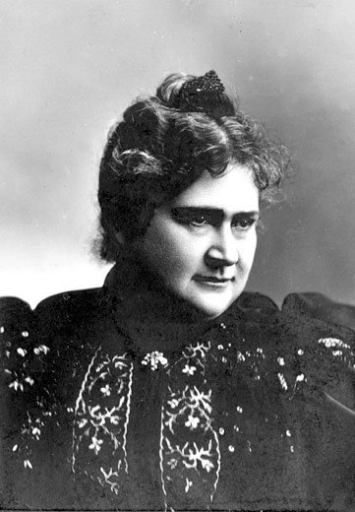

Notes:
Fact 6
Alice French (1850–1934)
Alice French was a leading writer of local color stories and journalistic essays under the pseudonym Octave Thanet. She later claimed that she chose “Octave” because it was gender-neutral.
She published stories and essays in such national periodicals as the Atlantic Monthly, Harper’s, Scribner’s Magazine, and Century Magazine. These were often republished in book-length collections. She also published several novels and a work about photography.
In the 1890s, French published ten books. Between 1896 and 1900, fifty of her stories were published, and four different publishers collected five volumes for reprinting.
A resurgent interest in American local color in the late twentieth century revived Thanet’s work. Some have read her stories as coded treatments of lesbian women.
She and her lifelong partner, Jane Allen Crawford, split their declining years between their homes in Davenport, Iowa, and Lawrence County, Arkansas.

Slide 13
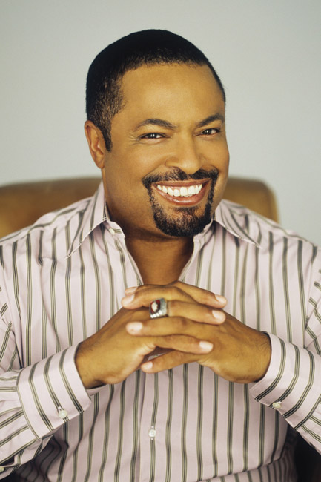

Notes:
Fact 7
E. Lynn Harris (1955–2009)
E. Lynn Harris was a bestselling author of novels about African American men in gay and bisexual relationships. In his nine novels, which have sold more than three million copies, the gay characters are “on the down low,” or have not publicized their sexuality. His books tell ultimately optimistic stories that explore friendship, careers, romance, sexuality, and race.
Harris, a Black man, endured years of abuse at the hands of his stepfather and for years denied his own homosexuality.
Harris graduated from Hall High School in Little Rock in 1973 and attended the University of Arkansas (UA) in Fayetteville (Washington County) in the mid-1970s. He was the school’s first Black male cheerleader and first Black yearbook editor, and he served as president of his fraternity, Alpha Phi Alpha. He graduated with honors in 1977, earning a BA in journalism.
Harris self-published "Invisible Life" in 1991. This novel caught the eye of a Doubleday sales representative, who bought a copy and sent it to the publishing house. Eventually, Harris made a presentation to company officials, who signed him to a three-book deal. Anchor Books, an imprint of Doubleday, published the book in trade paperback in 1994.
Just As I Am, Any Way the Wind Blows, and A Love of My Own all won Novel of the Year designations by the Blackboard African American Bestsellers Inc. In 1997, If This World Were Mine won the James Baldwin Award for Literary Excellence. His memoir, What Becomes of the Brokenhearted, which he wrote over a period of seven years, was published in 2003.
In 1999, Harris’s alma mater, UA, honored him with a Citation of Distinguished Alumni for outstanding professional achievement. In 2000, he was inducted into the Arkansas Black Hall of Fame. Other honors include the Sprague Todes Literary Award, the Harvey Milk Honorary Diploma, and the Silas Hunt Legacy Award for Outstanding Achievement from UA.
As a lecturer, Harris spoke at colleges across the country. He also wrote articles for Sports Illustrated, Essence, The Washington Post Sunday Magazine, The New York Times Book Review, The Atlanta Journal-Constitution, and The Advocate.

Slide 14
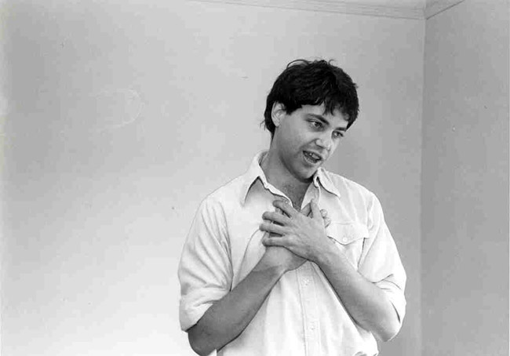

Notes:
Fact 8
Peter Gregory McGehee (1955–1991)
Gay Arkansas-born novelist Peter Gregory McGehee was praised by reviewers for his outrageous comedies of Southern manners, in particular the sly humor with which he explores what he saw as a hypocritical society that easily rationalizes its own moral lapses even as it enforces a narrow, judgmental morality upon others.
He was born in Pine Bluff and went to school in Little Rock. After college in Texas, he moved to California. While in San Francisco, he met Doug Wilson, a visiting Canadian gay rights activist. McGehee performed in a satirical musical review titled, The Quinlan Sisters, for which he wrote the lyrics.
In 1980, McGehee immigrated to Canada to be with Wilson. He wrote and performed in a one-man play (expanded and later published as the novella Beyond Happiness, 1985). He continued to perform in and write new material for The Quinlan Sisters as well as for a two-person revue, The Fabulous Sirs.
In the fall of 1988, McGehee was diagnosed to be HIV-positive. The progression of his HIV infection into full-blown AIDS in the spring of 1991 left him little time to enjoy the success that followed the publication of his first novel, Boys Like Us (1991), which was praised in the New York Times and elsewhere. McGehee was able to complete a second novel, Sweetheart (1992), and a collection of short stories, The I. Q. Zoo (1991), before his death; both works appeared posthumously, the latter only a week after his death.

Slide 15


Notes:
Fact 9
Danielle (Dani) Bunten Berry (1949–1998)
Dani Bunten Berry was a revolutionary computer game designer who specialized in multi-player games at a time when few in the industry were interested in the idea.
She is also remembered for breaking gender boundaries in the industry, having been assigned male at birth but undergoing gender transition late in her career.
Berry’s 1983 game M.U.L.E. was listed third on Computer Gaming World’s 1996 list of the best games of all time, and Will Wright, the designer of Sim City, once said, “Ask most game designers what their favorite computer game of all time is, and you’ll get M.U.L.E. as an answer more often than any other title.” She was a major influence upon the likes of Wright and Civilization designer Sid Meier.
In the early 1980s, Bunten founded Ozark Softscape in Little Rock as a venue for game development efforts. In 1982, Bunten was selected by Electronic Arts (EA), a recently founded company, as one of a handful of “electronic artists” it published, and Ozark developed five games for EA over the next few years. Bunten’s most well-known game is probably M.U.L.E. (1983).
Bunten was married three times and had two sons and one daughter. In 1992, after the end of Bunten’s third marriage, Bunten informed friends, coworkers, and family that she was embarking on the process of gender transition, adopting the name Danielle Bunten Berry (Berry being her mother’s maiden name). Berry underwent medical aspects of gender transition in November 1992. For the next several years, as a transgender woman, Berry withdrew from the game industry to concentrate on her transition.
In May 1998, shortly before her death, she received an award for lifetime achievement from the Computer Game Developers Association. Berry died of lung cancer on July 3, 1998. In 2007, she was named to the Academy of Interactive Arts and Sciences Hall of Fame.

Slide 16


Notes:
Fact 10
Boy Erased
Garrard Conley’s 2016 memoir Boy Erased recounts his experiences at the Memphis, Tennessee, “ex-gay” therapy program Love in Action, to which his parents sent him in 2004 upon learning that he was gay. A movie adaptation of the book was released in November 2018.
Conley grew up in northern Arkansas. His father served as a Missionary Baptist pastor. Conley was a Lyon College freshman when another student outed him as gay. In response, his parents sent him to Love in Action. His memoir is a painful reflection on his struggle to deal with his sexual orientation in a culture dominated by a conservative Christianity that disapproves of homosexuality.
In Boy Erased and interviews about it, Conley stressed that he wrote his book to give hope to others facing similar circumstances. As he told Bryan Borland of the Arkansas Times, the message he seeks to convey to others like himself is, “Hold on. Keep reading. Keep learning. Some day you will make it out. But don’t forget where you came from. There are people like you who haven’t made it out, and these people need your help.”
While Conley repudiated the “ex-gay” therapy on which his parents insisted and began living an openly gay life, he writes with sympathy for his parents, and, in particular, his mother, who supported his decision to leave Love in Action.
In 2008, Love in Action’s director Jon Smid resigned and in 2016 married his partner Larry McQueen. In his memoir Ex’d Out, he states that, in his view, “ex-gay” therapy is ineffective.
The movie adaptation of Boy Erased premiered on September 1, 2018, at the Telluride Film Festival and was released in U.S. theaters on November 2, 2018.
Boy Erased grossed $7.9 million at the box office. The film enjoyed strong critical reception, with critics praising the understated tone of the film and how each detail held resonant meaning. They also gave it high marks for helping to educate audiences about conversion therapy.
As a statement scrolling across the screen at the end of Boy Erased reminds viewers, thirty-six states, at the time the film was released, still permitted conversion therapy. As Conley indicated in a “Talks at Google” interview with Sanders Kleinfeld, before his memoir came out, “there hadn’t been a real definitive account, or at least a definitive literary account, of this type of therapy.” Kleinfeld noted that Boy Erased broke new ground in discussing the effects of conversion therapy in a detailed account not previously found in popular culture. As Conley stresses, the roots of this therapy run deep in the religious culture of some areas of the United States, including Arkansas.

Slide 17
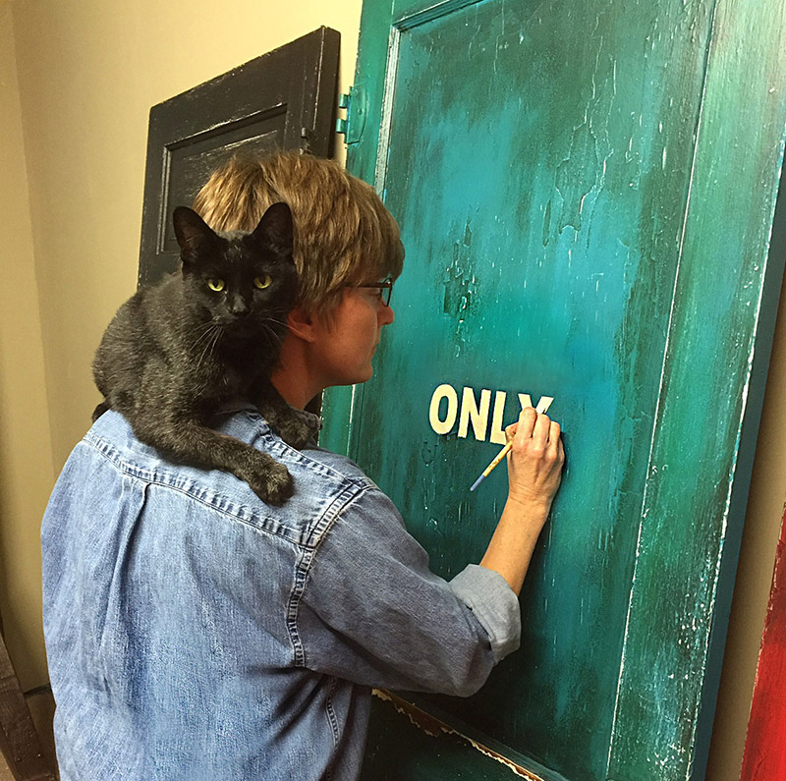
Notes:
Fact 11
V. L. Cox (1962–)
V. L. Cox is a painter and mixed media artist whose work has achieved national acclaim for confronting institutional racism and homophobia.
Vicki Lynette Cox grew up in Arkadelphia. When Cox was ten, her grandmother, Virginia Louise Pilkington Hardman, enrolled her in a children’s summer art program at Henderson State University. Later, after Cox's mother's substance abuse and physical abuse came to light, this grandmother became her legal guardian.
After enjoying athletic programs in high school and at Henderson, Cox attended Arkansas Tech University in Russellville before returning to Henderson.
Cox did marketing, advertising, set design, and construction for the Dallas Opera, the Dallas Ballet, and the Studios of Los Colinas.
She also designed and painted the theme and background for the National Civil Rights Humanities Awards in Memphis.
Cox returned to Arkansas to work for Alltel. In 1997, she quit her corporate work to devote herself to art. She originally sold her paintings under her full name but realized that using only “V. L.” allowed the focus to be on the artwork rather than her gender; her sales also increased.
Cox’s most publicized work has been a mixed media installation titled End Hate, which launched in 2015. The project was in response to the proposed Religious Freedom Restoration Act (Act 975 of 2015), which, as originally written, would have allowed discrimination against members of the LGBTQ+ community in Arkansas on the basis of religious beliefs. Governor Asa Hutchinson signed a modified version of the bill following national outrage.
The End Hate installation features a variety of different colored doors with labels on them such as “Colored Only” and “Whites Only” and “Veterans Only.” The last door in the sequence, labeled “Human Beings,” is wrapped in chains.
The doors were installed twice on the steps of the Arkansas State Capitol and then at the base of the Lincoln Memorial in Washington DC. Images of the doors went viral and attracted media attention nationally and internationally.
In 2018, after a national exhibition tour sponsored by the Longwood Center for the Visual Arts, the installation opened at the Rosa Parks Museum in Montgomery, Alabama, to coincide with the opening of the Equal Justice Initiative’s National Memorial for Peace and Justice in that same city.
In an interview with the Arkansas Democrat-Gazette, Cox described how the project “threw my whole personal life out there for everyone to see,” making her well-known as a lesbian artist.

Slide 18
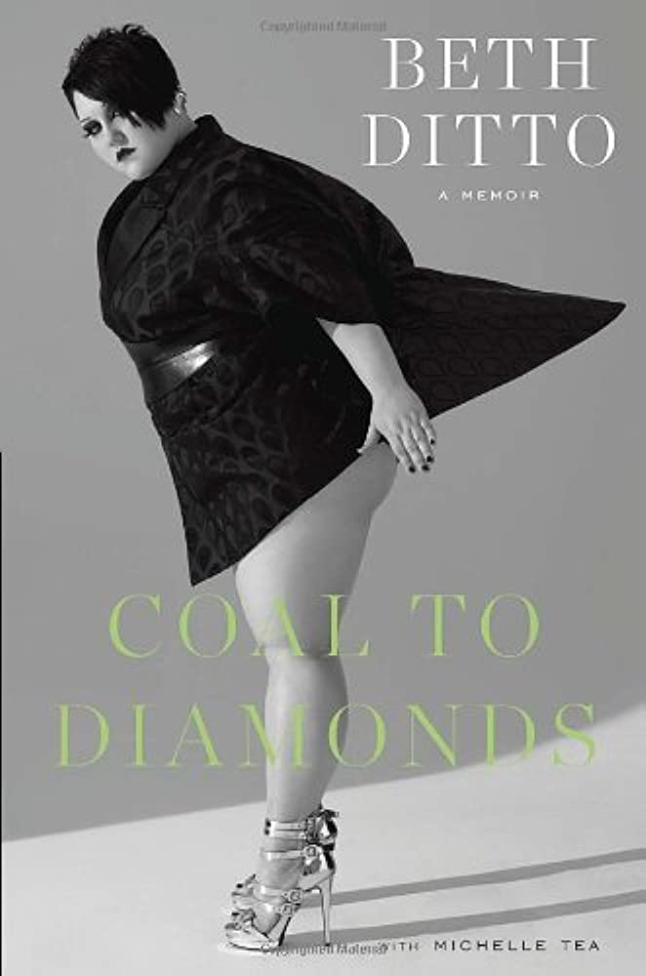
Notes:
Fact 12
Beth Ditto (1981–)
Beth Ditto has referred to herself as a “fat, feminist lesbian from Arkansas.”
White County native Beth Ditto, born Mary Beth Patterson in 1981, achieved renown as the singer and songwriter for Gossip, an indie, dance-punk band based in Portland, Oregon, before pursuing a solo career in music and acting. Ditto is also known for being a model and fashion designer who promotes positive body image, as well as for her outspoken support of LGBTQ+ rights.
Of her early music career, she stated, “We were radical feminist queers. No one’s goal was to become famous. Our goal was to pay our rent.” Even so, they did indeed become famous.
Gossip’s third studio album, Standing in the Way of Control, achieved gold record status in the United Kingdom. The title track was written as a protest against the Bush administration’s stance on gay marriage.
In 2006, Ditto became the first woman voted “Coolest Person in Rock” by NME, a long-running British music magazine.
In 2007, Gossip joined the multi-artist line-up of the True Colors Tour, the profits of which benefited the Human Rights Campaign.
From April 2007 to April 2008, Ditto contributed an advice column to The Guardian, titled, “What Would Beth Ditto Do?”
The band’s fourth studio album, Music for Men, was released in 2009, and the single “Heavy Cross” went triple gold in Germany.
Ditto’s weight has garnered much media attention, and she promotes positive body image and has been featured nude on the cover of several magazines, including NME and Love. In October 2010, she modeled for designer Jean Paul Gaultier’s spring 2011 fashion show during Paris Fashion Week.
In 2011, Ditto released the EP Beth Ditto. The band released a fifth studio album in 2012, the same year Ditto’s memoir, Coal to Diamonds, was published. In this memoir, Ditto speaks out against racism, homophobia, and fatphobia, while also exposing the male privilege and sexism that permitted the rampant multigenerational sexual abuse in her family.
Ditto married longtime girlfriend Kristin Ogata in Maui, Hawaii, in July 2013; they divorced in 2018. Ditto split from Gossip to pursue her solo career in 2016 and released her first solo album in 2017.
Ditto resides in Portland, Oregon where she teaches at Rock ‘n’ Roll Camp for Girls, a program designed to empower young musicians.
She was featured in various acting roles in 2014, 2016, 2018, 2019, 2021, and 2022.
In an interview in the fall 2022 issue of Bust magazine, Ditto opened up about her current relationship with transgender musician Teddy Kwo and about how Gossip reunited in 2019 for a series of European shows before the COVID-19 pandemic. She mentioned a forthcoming Gossip album.

Slide 19

Notes:
Fact 13
Diana Rivers (1931–)
Diana Rivers is an author, artist, and promoter of women’s communities and art venues. Rivers has published numerous short stories and eight novels in the genre of speculative fiction, seven of which compose the Hadra series. Rivers lives in Madison County.
Diana Rivers was born Diana Duer Smith. Many of the women in her family were writers and artists.
After having a son and getting divorced, Rivers eventually settled in Boxley Valley near Jasper (Newton County), where she started an intentional community. After a few years, Sassafras, as the community was called, became an all-women’s community. Rivers chose her last name in honor of her new life. She built her own cabin in the woods and began writing short stories based on her community experiences. She published these stories in magazines such as Sinister Wisdom, Feminary, Conditions, and Common Lives/Lesbian Lives. This was also where she wrote her first novel.
Rivers left Sassafras in 1980, wanting to start an intentional women’s land community closer to Fayetteville (Washington County). With nineteen other women, the Ozark Land Holding Association was created on several hundred acres and remained an active community in the twenty-first century.
Rivers published her first novel in the Hadra book series, Journey to Zelindar (Lace Publication), in 1987. The main theme running through these novels is love and conflict between women as they struggle to create community and an alternative way of life in the face of patriarchal oppression.
Rivers is a Pagan and an ardent lesbian-feminist involved in supporting gay rights issues as well as advocating for peace, racial equality, social justice, and ecology. She was particularly active in opposing and demonstrating against the Vietnam War and the Iraq War. Fayetteville’s OMNI Center for Peace, Justice & Ecology acknowledged Rivers as one of the Arkansas Peace and Justice Heroes in 2005. Rivers is also an amateur naturalist.
Rivers designed her own house and helped the all-women crew to build it. Her life partner lives in her own house nearby.

Slide 20
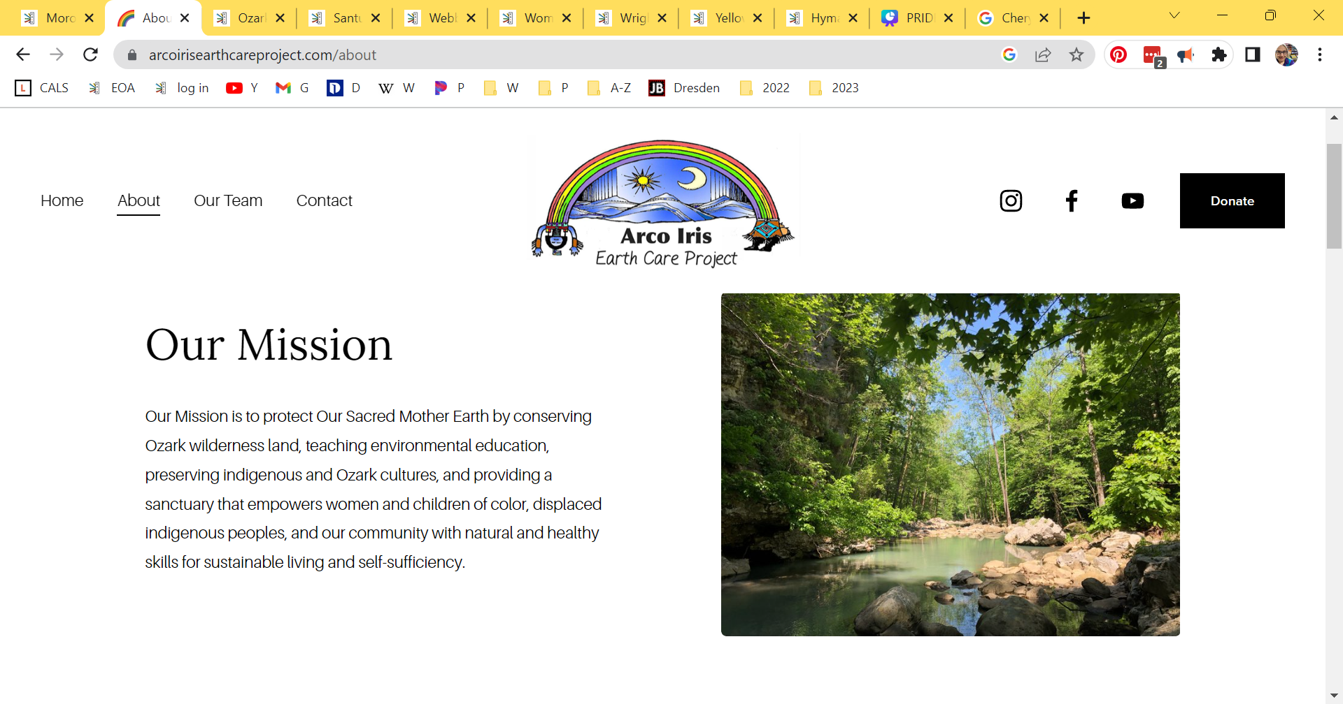
Notes:
Fact 14
Maria Christina DeColores Moroles (1953–)
Maria Christina DeColores Moroles (also known by the ceremonial names Sun Hawk and Aguila) is best known for founding and maintaining Santuario Arco Iris, an intentional land community in Ponca (Newton County) designed specifically as a “sacred land space” for women and children, especially marginalized women and children of color. Moroles, a so-called two-spirit woman of Mexican and Indigenous American descent, began living on the 500-acre wilderness preserve in 1976. (Moroles prefers the pan-Indian term “two spirit” to the term “lesbian” to describe a third or non-binary gender identification and sexual orientation that derives from Native American ceremonial roles and culture.)
At age fifteen, Moroles married David Paige; their daughter, Jennifer Jo, was born in 1971. She then moved to northwestern Arkansas, where she became involved in the burgeoning women’s community.
Initially, in 1976, Moroles and her daughter lived on property in Ponca owned by a lesbian land collective called Sassafras. Moroles then negotiated with the Sassafras Women’s Community to deed 120 acres of land, now known as Santuario Arco Iris, to women of color. In 2000, the original purchaser of the Sassafras land, activist and artist Diana Rivers, and Moroles agreed to place the remaining 400 acres of what was then called the Wild Magnolia land under the stewardship of the nonprofit Arco Iris Earth Care Project (AIECP). Moroles and her then-partner Miguela Borges reared a second child, Mario, born in 1988, on the land.
The signal contribution that Moroles has made to the people and history of Arkansas over four decades has been her commitment to living on and preserving the 500-acre wilderness preserve in the Ozarks, which includes both Santuario Arco Iris and the AIECP. Through this commitment, Moroles has provided a safe place of retreat for women and children of color from Arkansas and beyond, offered an array of natural healing treatments to all who requested them, and served as the “matriarchal steward” of an intentional community devoted to Indigenous American, ecofeminist, and anti-racist principles.

Slide 21

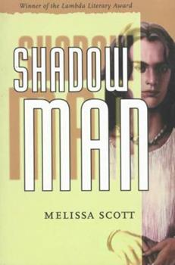
Notes:
Fact 15
Melissa Elaine Scott (1960–)
Melissa Elaine Scott became one of the most honored and prolific authors of English-language science fiction. Over nearly forty years, she has published eighteen original novels, several short stories, and numerous tie-in novels for the science-fiction network-television series Star Trek and Stargate: Atlantis. Her fiction has been noted for the frequency of lesbian and gay characters, who were often the protagonists. In the 1980s, even among book lovers, there was little knowledge or acceptance of the biological and social diversity of human life in the area of gender and sexuality. The genre of science fiction furnished young Scott a literary medium—the far-away future of cyberspace and interstellar travel—in which LGBTQ+ identities were not met with condemnation.
Scott was born in Little Rock and grew up in the Little Rock area. She got her bachelor’s degree in history at Harvard College in 1981, where she helped produce a college-sanctioned science-fiction magazine. She enrolled in the graduate program of comparative history at Brandeis University in Boston; published her first novel; and earned a master’s degree and a doctorate.
In Boston, she met Lisa Anne Barnett, a writer and editor who attended the nearby University of Massachusetts, and with whom she would collaborate on three novels. The two settled in Portsmouth, New Hampshire. In February 2000, seven months after Vermont became the first state to recognize civil unions of gay couples, Scott and Barnett went to Burlington and had their union officially legalized. Barnett died of breast and brain cancer in 2006.
Scott only rarely made gender and sexuality the overt theme of a story; rather, the disparate sexualities of the characters were merely noted and occasionally explicitly described, as had long been the case for heterosexual characters in other genres of fiction. The lone book that deals predominantly with the theme of gender and sexual acceptance is Shadow Man (1995), in which, eons from the present, a drug taken to survive interstellar travel increased intersex births and led across the universe to the recognition of five body types—except in the planet of Hara, where only two body types were recognized: female and male.

Slide 22
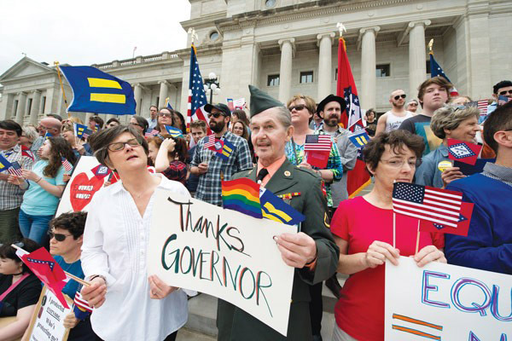
Notes:
Fact 16
Robert Loyd (1949–2015)
Robert Loyd—along with his husband, John Schenck—was an activist for LGBTQ+ rights in Arkansas, especially same-sex marriage. He was also a business owner and a veteran of the Vietnam War. Loyd and Schenck co-founded Conway’s Pride Parade and were plaintiffs in Wright v. Arkansas, a challenge to the state’s ban on same-sex marriage.
In 1968, at his parents’ insistence, Loyd joined the U.S. Army, leaving to fight in the Vietnam War in March 1968. He worked in communications, often in areas that saw extensive fighting. After leaving Vietnam, he was stationed in Colorado and then Germany.
Loyd left the army in 1970, moving to West Palm Beach, Florida, to work as a hairdresser. As his clients often spent most of the year in New York, he had many of the same clients as John Schenck, a hairdresser working on Long Island. They learned of these shared clients after they began dating. Loyd moved to New York, and the couple then moved to Arkansas in 1978 to care for Loyd’s mother after the death of Loyd’s father.
Loyd and Schenck opened the Lion’s Den hair salon in an old gas station outside of Damascus, and then opened others in Greers Ferry (Cleburne County), Heber Springs (Cleburne County) and Little Rock (Pulaski County). They moved to Conway (Faulkner County) in 1986 and soon purchased a Victorian house near downtown. They opened the Special Effects salon in the house, which they eventually painted bright pink. Later, a “Teach Tolerance” sign was added, and the fence around the yard was painted in rainbow colors.
The couple did not involve themselves in gay-rights activism until a conflict with Conway and Faulkner County law enforcement in 2003, which they saw as motivated by homophobia, and public anti-gay comments from Governor Mike Huckabee. They said they lost many salon clients at first because of their activism.
In 2004, Loyd and Schenck organized the first annual Conway Pride Parade; about 100 people marched in the parade, while there were more than 1,000 protestors. One protestor, Wesley Bono, dumped several tons of cow manure along the parade route before dawn on the day of the parade; he was eventually found guilty of misdemeanor harassment and fined. Two other protestors—Cristina Brown and Little Rock talk radio personality Phillip Beard—tossed pornographic DVDs to attendees of the parade; they negotiated a plea for misdemeanor charges at their trial. The parade became an annual event, drawing more marchers and fewer protestors over the years.
The couple became legally married in Canada in 2004. In 2005, a documentary film about Loyd and Schenck’s activism, Pink Houses, was released.
Loyd and Schenck became plaintiffs in the 2013 case Wright v. Arkansas, which was seeking to end the state’s 2004 ban on same-sex marriage and non-recognition of out-of-state same-sex marriages. On May 9, 2014, Pulaski County circuit judge Chris Piazza struck down the ban on same-sex marriages. Couples began obtaining marriage licenses the next day in some counties. Loyd and Schenck were at the Pulaski County Courthouse to support the dozens of same-sex couples who were able to marry before the state halted same-sex marriages a week later, but they decided to wait to marry until they could get a marriage license in Faulkner County. The case was then appealed, and county clerks ceased giving out marriage licenses to same-sex couples.
On June 26, 2015, with a 5–4 ruling in the case of Obergefell v. Hodges, the U.S. Supreme Court announced that states cannot ban gay marriage, legalizing it nationwide (and thereby closing the Wright case). Loyd and Schenck received their marriage license at the Faulkner County clerk’s office that same day, the first same-sex couple in Faulkner County to do so. The couple married in Conway on August 22, 2015, with Conway mayor Tab Townsell performing the ceremony.
Loyd died suddenly of a heart attack on December 30, 2015. The 2016 Conway Pride parade was dedicated to his memory.
According to Loyd’s obituary, he and Schenck were officially foster parents for eleven years and unofficially for many more (including being “fairy godfathers” to Justin Rawls). They particularly helped young people who had been abandoned due to their sexual orientation; they served as legal guardians for four children over the years. Schenck died in 2016.

Slide 23

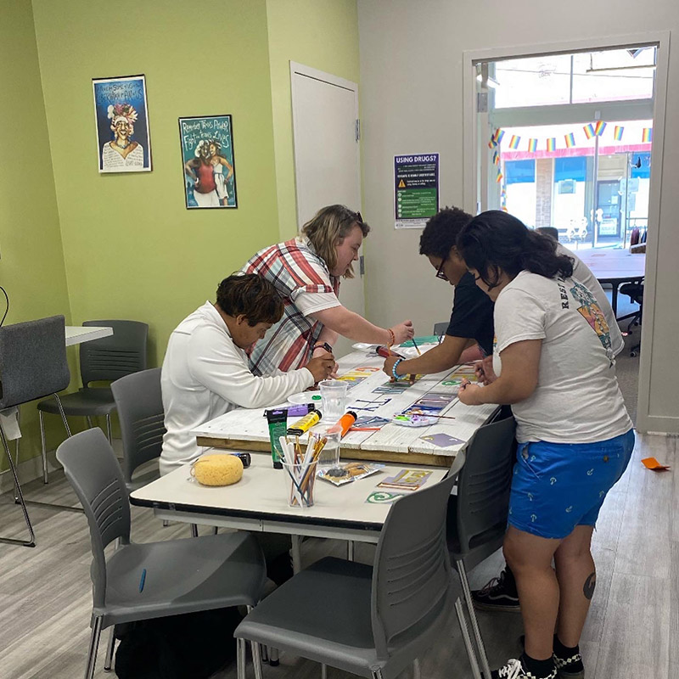
Notes:
Fact 17
Lucie's Place
Lucie’s Place of Little Rock (Pulaski County) is a nonprofit organization providing support for LGBTQ+ (lesbian, gay, bisexual, transgender, and questioning/queer) young adults experiencing homelessness in central Arkansas. Lucie’s Place aims to provide housing, resources, case management, and job skills training. Lucie’s Place is the only organization in Arkansas working to support young LGBTQ+ people experiencing homelessness.
Lucie’s Place was founded by Penelope Poppers. After the death of her friend Lucie Marie Hamilton in 2009, Poppers wanted to start an organization to serve the LGBTQ+ community in honor of Hamilton, who was a mentor and advocate to many. In 2011, Poppers—along with Diedra Levi, Mike Lauro, and Karen Thompson (Hamilton’s mother)—planned community meetings, mostly at Boulevard Bread Company on South Main Street in Little Rock, to gauge the level of support among neighbors and community members. Poppers and her team also strove to communicate the pressing need for services to homeless LGBTQ+ young people. According to a study by the American Center for Progress, forty percent of individuals experiencing homelessness identify as LGBTQ despite the fact that LGBTQ+ people make up only five to ten percent of the general population. Lucie’s Place officially gained 501(c)(3) nonprofit status in June 2012, and much of the organization’s early focus was on reaching out and teaming up with other homeless service providers in the state to advocate on behalf of LGBTQ+ people seeking those services.
Lucie’s Place gained national attention in 2014 when activist Scott Wooledge of New York began an online campaign to counter anti-LGBTQ+ statements made by northwestern Arkansas residents Michelle Duggar and Jim Bob Duggar of the television show 19 and Counting. Wooledge urged followers to counteract the Duggar messaging by donating to Lucie’s Place. The donations brought in by this campaign all over the world helped Poppers to open the drop-in center in the 300 Spring Street Building in August 2015. The location served as a hub where members could come for intake, case management, and other support. It also served as office space for Poppers and her staff.

Slide 24
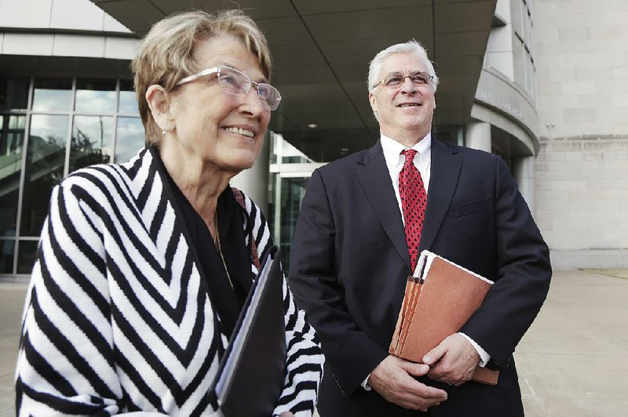
Notes:
Fact 18
Cheryl Kathleen Smith Maples (1950–2019)
Cheryl Kathleen Smith Maples was a prominent attorney in Little Rock (Pulaski County) and throughout the state. An outspoken champion of equal rights for all, she was particularly well known for her work on behalf of the LGBTQ+ community.
As the issue of gay and lesbian rights came to occupy an increasingly prominent place in the American legal landscape in the early part of the twenty-first century, Maples emerged as arguably Arkansas’s most devoted and outspoken advocate of equal rights for gays and lesbians. She filed the nation’s first challenge to a state ban on gay marriages, a suit that led to an initial lower court ruling that overturned the state prohibition (Wright v. Arkansas). Consequently, for a brief period, before an appeal to the Arkansas Supreme Court put a stay on the lower court ruling, same-sex couples were allowed to marry in Arkansas. The full-scale appeal of the lower court ruling was pending when the U.S. Supreme Court’s Obergefell v. Hodges decision in 2015 rendered the state-based suit moot by making same-sex marriage legal nationally.
Maples once commented that her efforts on behalf of gay rights were in honor of her daughter, who was a lesbian. Two years after the Obergefell decision, in 2017, she led the effort in Pavan v. Smith, in which the U.S. Supreme Court struck down the Arkansas statute that prohibited putting the name of the second parent of a same-sex marriage on the birth certificate of their child, a decision that built upon the fundamental rights recognized in Obergefell, while expanding the full meaning of marriage and family for same-sex couples all over the United States.

Slide 25
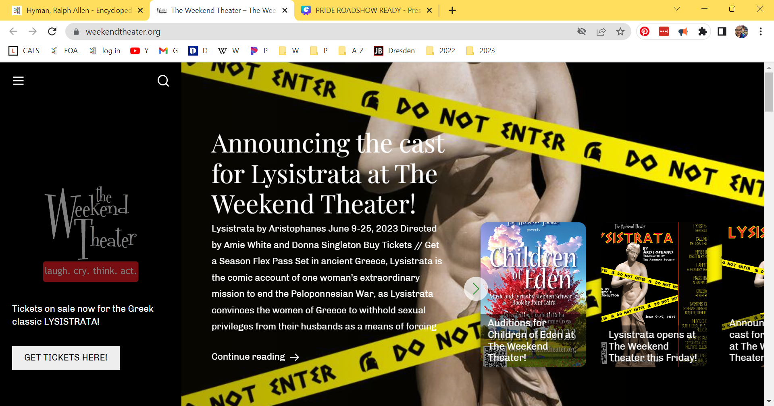
Notes:
Fact 19
Ralph Allen Hyman (1951–)
Ralph Allen Hyman, an activist on behalf of LGBTQ+ rights, as well as for those with AIDS, was the first openly gay candidate for the Arkansas General Assembly. He also was a cofounder of the Arkansas Gay and Lesbian Task Force, the Arkansas AIDS Foundation, and The Weekend Theater.
He came out as gay at the age of eighteen. His graduate studies focused on homosexuality and the mental health profession. Choosing Little Rock as his permanent residence, Hyman established a private practice. His clientele included those with mental illnesses, people struggling with their sexuality, AIDS patients, and transgender people. He also established support groups for gay men and lesbians, transgender people, and their families. In 1981, he met his life partner, Mark Terry Burnette, a civil rights and education law attorney.
A committed activist, he joined Arkansas Gay Rights (AGR), a gay and lesbian rights organization. Upon AGR disbanding in 1986, he and other activists founded the Arkansas Gay and Lesbian Task Force.
A Democrat, he ran for state representative from District 59 in 1990—the first openly gay candidate for the Arkansas General Assembly. His platform included the repeal of the sodomy law and the adoption of hate crimes legislation, as well as measures supporting AIDS education, reproductive rights, tax reform, and the prevention of domestic violence. He did not win the seat.
In response to the AIDS epidemic, Hyman educated the public in safer-sex measures, including the use of condoms. He spoke to the public at press conferences, as well as speaking before community and professional groups, university classes, and Arkansas Governor’s School. Asserting that AIDS was not a “gay disease,” he warned that the malady also affected the heterosexual community. With no AIDS hotline in place at the time, he gave out his phone number. He established a “buddy system,” with volunteers helping AIDS patients with various tasks. He founded AIDS House, providing a living space for disowned HIV+ men. He cofounded the Arkansas AIDS Foundation (AAF) in 1985, which assumed management of AIDS House. In June 1988, his AIDS work was recognized with an Arkansas Community Service Award. During his acceptance speech, Hyman proclaimed, “I am a homosexual.” He asserted that the award recognized not just his contributions, but also those of the state’s gay and lesbian community. He also requested donations to support AIDS House.
In 1989, upon learning that most funds donated to the AAF went to salaries and office expenses, he withdrew from the organization. Without his consent, AIDS House was closed in 1991.
He redirected his energies to a lifelong passion: the theater. In 1994, he and friends founded The Weekend Theater. Both acting in and directing plays, he served as the theater’s artistic director through 2014. During his tenure, the theater produced more than 200 plays and musicals. He retired in 2015.

Slide 26
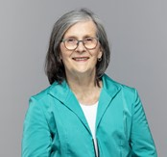
Notes:
Fact 20
Kathy Lynette Webb (1949–)
Kathy Webb—the first openly gay member of the Arkansas General Assembly—has had a long career in private business (most notably as co-owner of Lilly’s Dim Sum Then Some restaurant), philanthropy, and local and state government. She has also been a leader in the women’s rights movement. Webb, who battled breast cancer, served as the founding president of the Chicago-area Susan G. Komen Cancer Foundation.
Webb was actively involved in the women’s movement, becoming head of the Pulaski County affiliate of the National Organization for Women (NOW). In 1982, she won election as national secretary, the only winning candidate who had not been endorsed by the incumbent administration. She was subsequently reelected and served in that position through the end of 1987.
In 2000, Webb returned to the South, becoming the co-owner and co-founder of Lilly’s Dim Sum Then Some in Memphis, Tennessee. She and her business partner (and romantic partner at the time), Nancy Tesmer, started a second Lilly’s Dim Sum Then Some in Little Rock in 2002. Webb left the business in 2011.
Webb sought elective office for the first time in 2006. Running as a Democrat, she won election to the Arkansas House of Representatives. She became the first woman to chair the Joint Budget Committee. She also served as chair of the Arkansas Assembly Economic and Tax Policy Committee and was a member of the House Rules Committee; the Arkansas House Education Committee; the City, County and Local Affairs Committee; and the Arkansas Legislative Council. Webb twice won reelection, running unopposed in both 2008 and 2010.
In 2014, Webb sponsored and shepherded through to passage a city ordinance prohibiting the City of Little Rock (and companies with which it contracted) from discriminating based on sexual orientation or gender identity; this was in conflict with a recently enacted state law that prohibited local government from expanding anti-discrimination protections.

Slide 27

QUESTIONS
Notes:
This is just the tip of the iceberg. The Encyclopedia of Arkansas is a rabbit hole I encourage you to jump down. No matter what you are interested in, Arkansas has it--and the EOA is where you can start looking.

