Slide 1
email: info@cals.org

Slide 2
encyclopediaofarkansas.net
Notes:
What is the CALS EOA?
CALS is the Central Arkansas Library System
EOA stands for
Encyclopedia of Arkansas
encyclopediaofarkansas.net

Slide 3
fun facts
Notes:
The EOA went live in 2006 with approximately 700 entries and 900 pieces of media. Today the EOA has more than 7,000 entries and more than 14,000 pieces of media and is still growing!
1,664 authors have contributed thus far. Some authors write only 1 entry, while others have contributed over 300!
The EOA has surpassed arkansas.com as the number-one search result for many Arkansas-related inquiries.

Slide 4
big numbers
Notes:
The EOA receives hundreds of thousands of visits from all over the world every month. In 2022, for example, the EOA had 2,042,126 sessions, 1,689,041 users, and 3,274,241 page views.
Top 15 visitors to the EOA after the US include: Canada, the United Kingdom, China, Australia, Russia, Germany, India, the Philippines, France, New Zealand, Ireland, the Netherlands, Sweden, Nigeria, and Brazil.

Slide 5
top 15
Notes:
Top 15 most viewed entries for 2022 were:
Sundown Towns
West Memphis Three
Elaine Massacre of 1919
Tony Alamo
Martha Mitchell
Ronald Gene Simmons
Little Rock Nine
Titan II Missile Explosion
Helen Spence
Jeff Keith
Duggar Family
Trail of Tears
One Drop Rule
Indian Mounds
Arkansas Black Hall of Fame

Slide 6
Notes:
Meet the Team (from left to right):
Michael “Sterno” Keckhaver
Media Editor
Guy Lancaster
Head Editor
Ali Welky
Associate Editor
Mike Polston
Staff Historian
Jasmine Jobe
Editorial Assistant

Slide 7
what we do
Notes:
Michael “Sterno” Keckhaver handles photography and all media-related tasks.
Guy Lancaster handles initial editing, compiling queries, and database updates.
Ali Welky handles final editing and proofreading as well as the EOA Facebook page.
Mike Polston handles reviewing and fact checking.
Jasmine Jobe handles correspondence and uploading.

Slide 8
THE
history
resource
Notes:
The EOA has everything you could ever need or want to research in Arkansas history:
The Louisiana Purchase, the Civil War and Reconstruction, steamboats, WWI, WWII, Korean War, Operation Desert Storm.
Legislature, politicians, judges, court cases, hospitals, doctors, religions and denominations, cultural groups, media, newspapers, radio stations, television stations.
Racial violence, slavery, lynchings, Jim Crow laws, the civil rights movement of the 20th Century, historic preservation.
The official state motto, nicknames, songs, instrument, mammal, insect, tree, flower, grain, rock, mineral, soil, AND MORE.

Slide 9
casting a
wide net
Notes:
We may be the top source on Arkansas history, but we also keep up with other subjects:
Science, Geography, Environment, Climate, Natural Disasters
Music, Movies, Books, Arts, Culture
Festivals, State Parks, Restaurants, Museums, Schools, Cities, Towns
Famous people with Arkansas connections, historic and current

Slide 10
keeping current
Notes:
We work hard to keep all entries up to date, and we also keep up with current topics.
We have entries on:
-Tornado Outbreak of 2023
-Flood of 2019
-COVID-19
-Black Lives Matter
-The reorganization of state government agencies
-Abortion
-LGBTQ+
-And many more

Slide 11
connect
with us
Notes:
Peruse our blog,
https://encyclopediaofarkansas.net/blog/
Check out our Facebook page, https://www.facebook.com/cals.eoa/
and don't forget to subscribe!

Slide 12
BOTTOM LEFT CORNER OF OUR WEBSITE
Notes:
Peruse our blog,
https://encyclopediaofarkansas.net/blog/

Slide 13
BOTTOM RIGHT CORNER OF OUR WEBSITE
Notes:
Check out our Facebook page, https://www.facebook.com/cals.eoa/

Slide 14
BOTTOM LEFT CORNER OF OUR WEBSITE
Notes:
And don't forget to subscribe.

Slide 15
Notes:
And don't forget to subscribe.

Slide 16
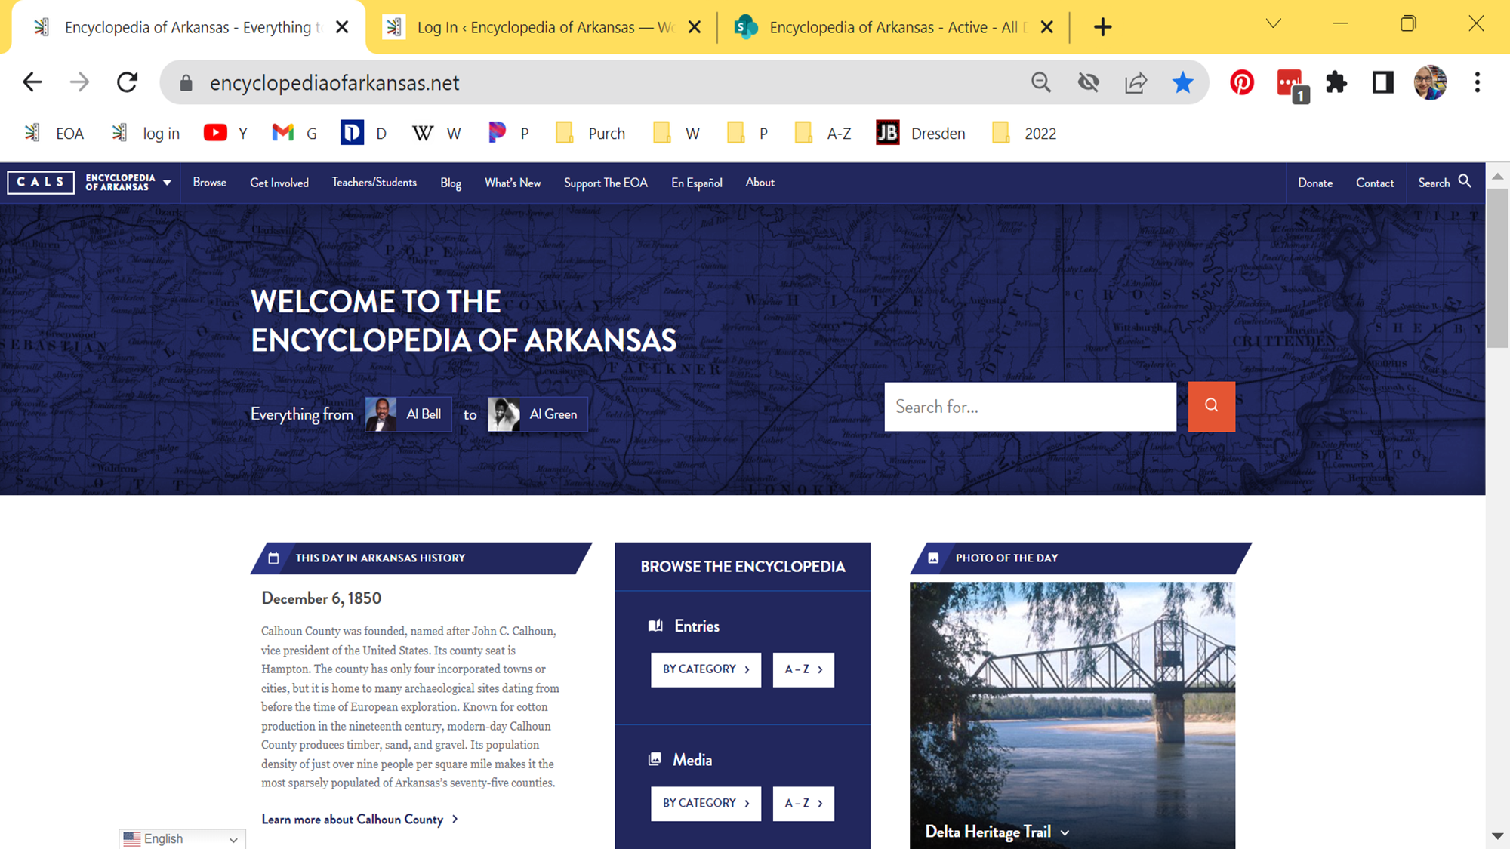
Notes:
If you're viewing our site on a computer it'll look like this.
The "Search" bar is conveniently located at the very top.

Slide 17
Notes:
The sections will include "This Day in Arkansas History," "Browse," and "Photo of the Day."

Slide 18
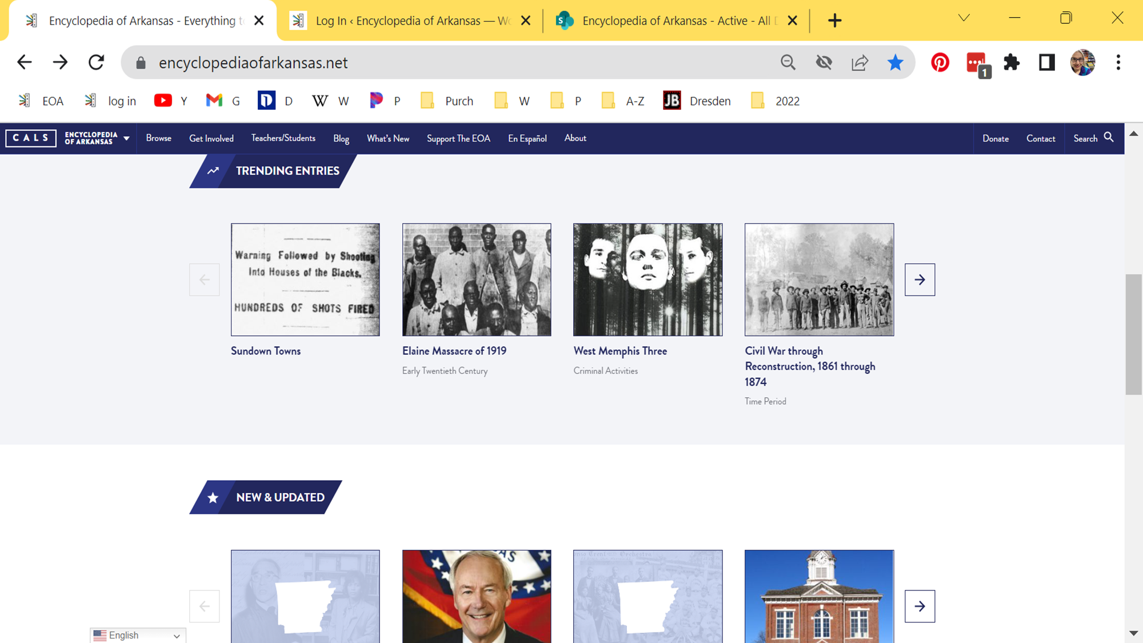
Notes:
If you scroll down you'll see the additional sections "Trending Entries" and "New and Updated."

Slide 19
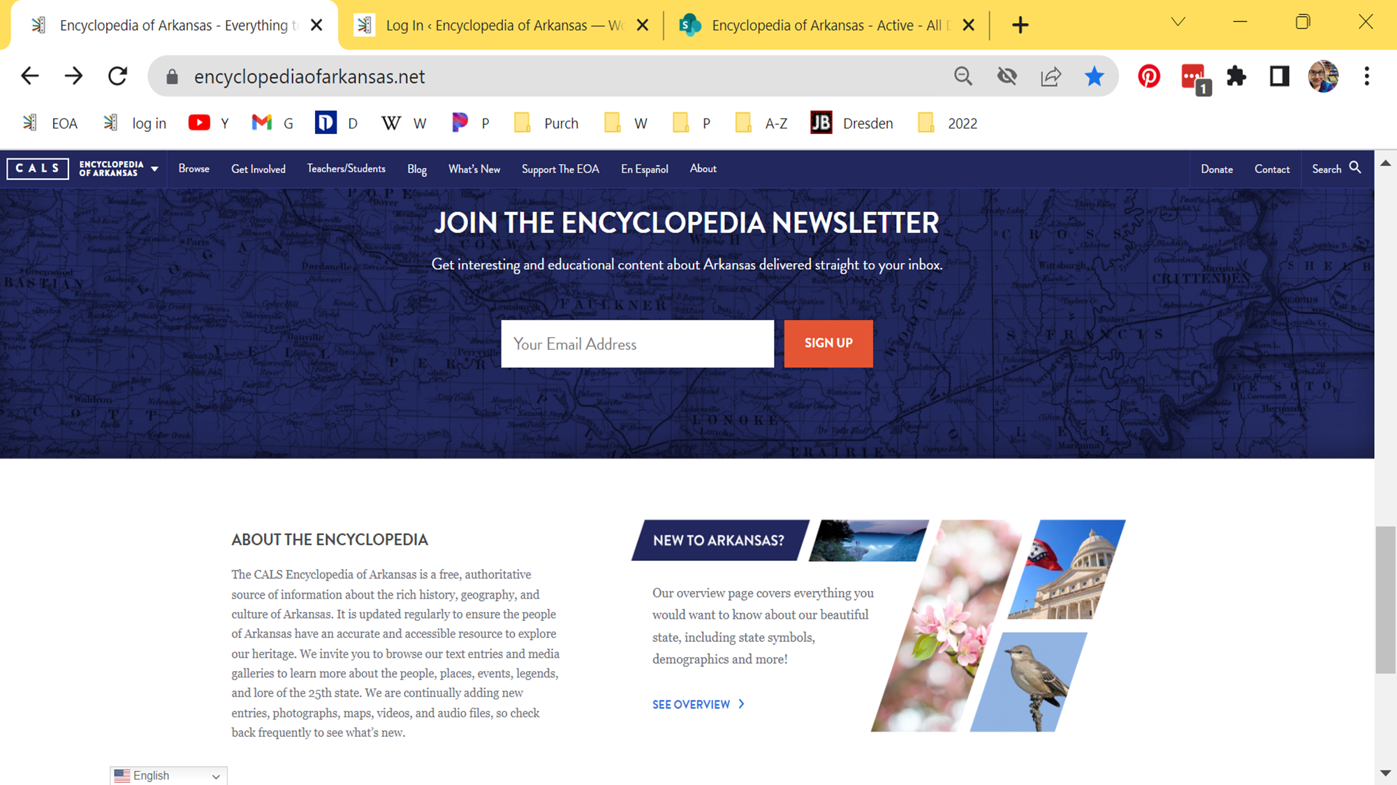
Notes:
If you continue scrolling down you'll see another chance to subscribe and, if you're not sure where to start, you'll see we have a link to our "Overview" entry.

Slide 20
Notes:
If you're viewing our site on a phone it'll look like this.
The "Search" bar is still conveniently located at the top.

Slide 21
Notes:
The sections will include "Browse," followed by:

Slide 22
Notes:
"This Day in Arkansas History," and "Photo of the Day."

Slide 23
Notes:
If you scroll down you'll see the additional sections "Trending Entries" and

Slide 24
Notes:
"New and Updated."

Slide 25
Notes:
If you continue scrolling down you'll see another chance to subscribe and

Slide 26
Notes:
if you're not sure where to start, you'll see we have a link to our "Overview" entry.

Slide 27
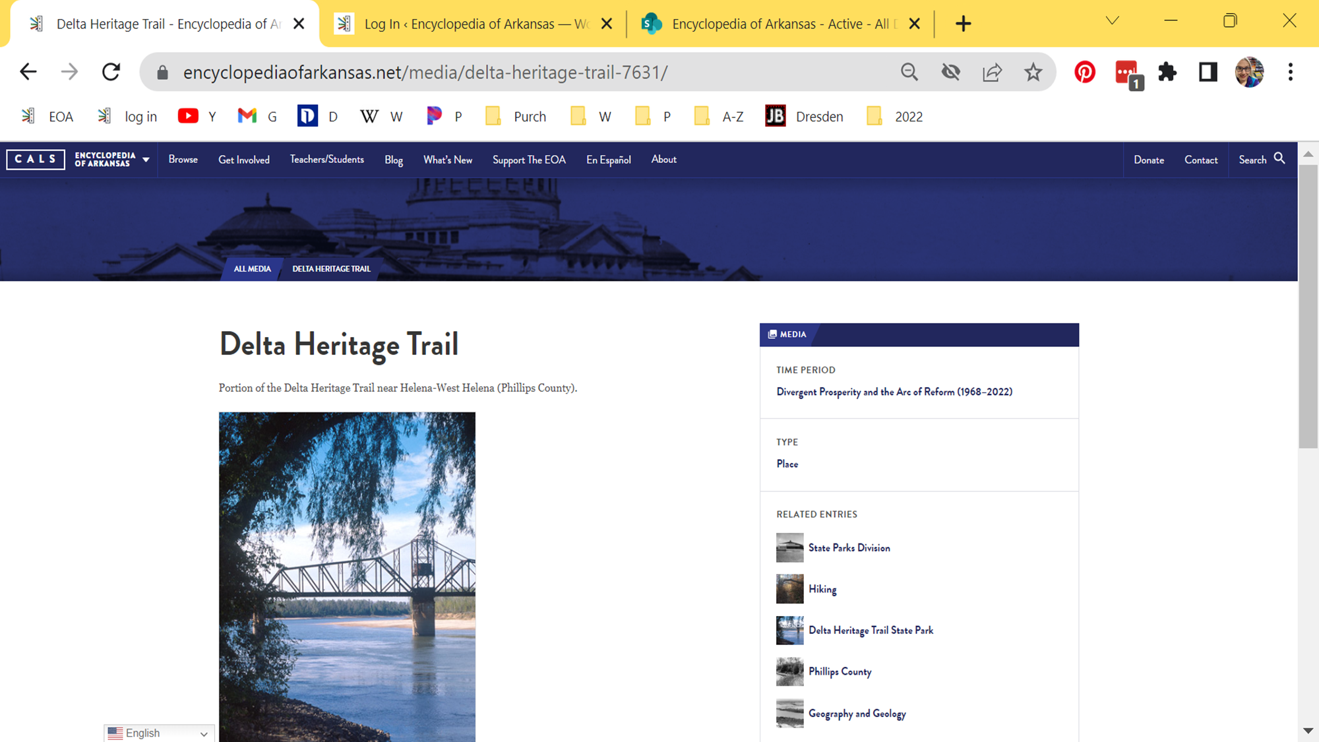
Notes:
If you're exploring the "Photo of the Day" section, it'll look a lot like this. There will be a main piece of media with a title and short caption as well as related entries off to the right.

Slide 28
Notes:
If you're exploring the "This Day in Arkansas History" section, it'll look a lot like this. There will be a title at the top of the entry as well as related media and entries off to the right.

Slide 29
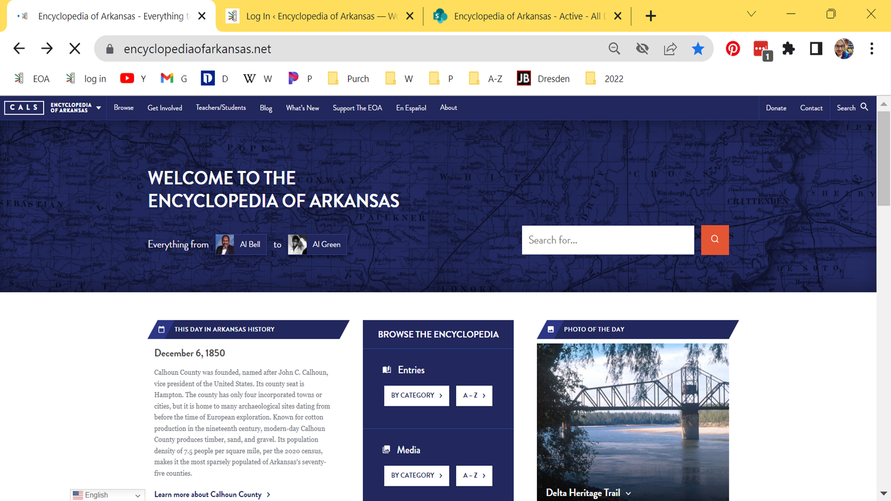
Notes:
We have two clickable search functions. We started with a small button in the top right but it was difficult to find for some of us so we added a larger search bar as well.

Slide 30
Notes:
If you start typing in either search field, related entries will populate for you to click on. If these aren't what you're looking for, just hit "enter" to complete your search and view full results.

Slide 31
Notes:
The same will happen regardless of which "search" you click on.

Slide 32
Notes:
Along the top bar, you can hover over the "Browse" menu to view the drop down options, such as "All Entries."

Slide 33
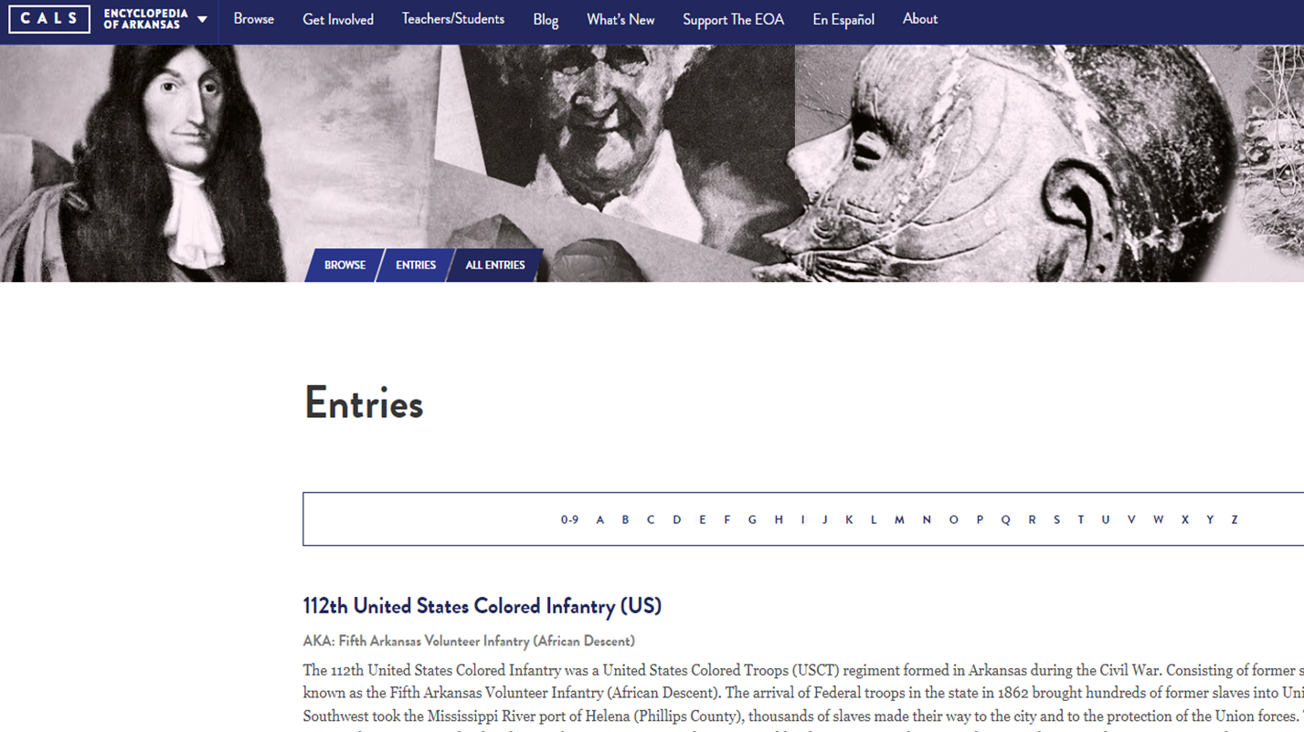
Notes:
Clicking "All Entries" will take you to a page that looks like this.

Slide 34
Notes:
Along the top bar, you can hover over the "Browse" menu to view the drop down options, also including "All Media."

Slide 35
Notes:
Clicking "All Media" will take you to a page that looks like this.

Slide 36
Notes:
Another option along the top menu is "What's New."

Slide 37
Notes:
Clicking on "What's New"
will take you to a page that looks like this.
If you click on an individual entry title,

Slide 38
Notes:
You will be taken to that individual entry page. Again, you'll see the title of the entry and the body of the entry text taking up about two thirds of the page. Related media and links will be on the right hand side.

Slide 39
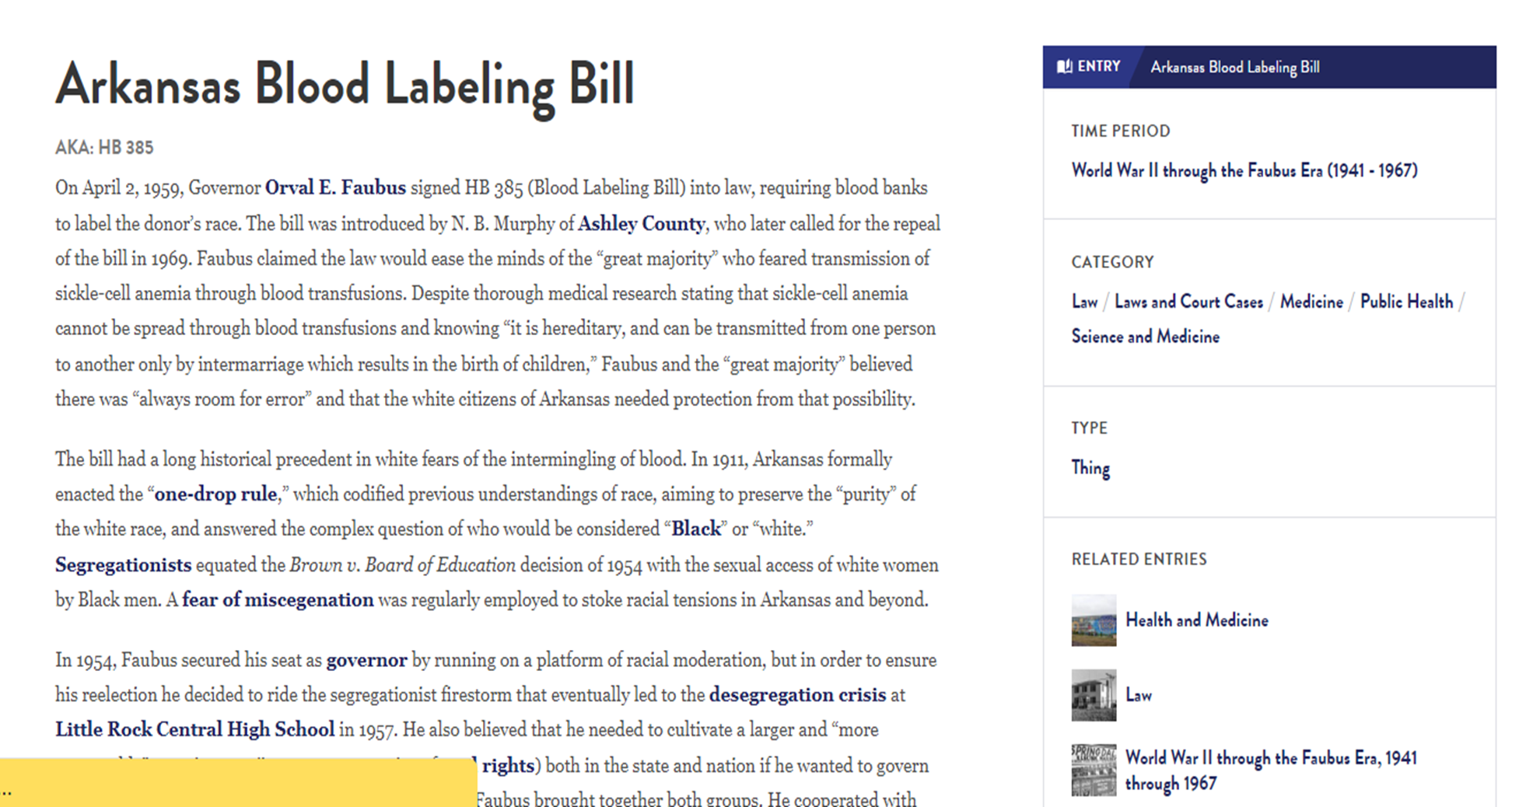
Notes:
Every instance of words in BOLD text is another link to another entry.

Slide 40
email: info@cals.org
Notes:
If you're interested in suggesting an entry or writing an entry, you can click on "Get Involved" to learn more. Or, just email "info@cals.org"

Slide 41
media drive
email: mkeckhaver@cals.org
Notes:
Do you have new or old photos to contribute? Send them to Media Editor Michael Keckhaver:
[ m k e c k h a v e r @ c a l s . o r g ]
Be sure to tell us all relevant info about the photo: what is in the photo, when was the photo taken, who is in the photo, and who took the photo. We look forward to publishing your photo!

Slide 42
Thanks!
Questions? Comments? Concerns?
Just drop us a line! We're always happy to hear from you.
email: info@cals.org

