Slide 1
10 THINGS
YOU MIGHT NOT
KNOW ABOUT
THE NATURAL STATE
Notes:
Whether you're a born and raised Arkansans, lived here for 30 plus years or recently arrived to the Natural State, this place we call home has a rich, diverse, and fascinating history.
And for the past 16 years the staff of the Encyclopedia of Arkansas has tried to make sure that the story of this place is documented in an accessible digital format.
This free resource has almost everything you might want to know about the 25th state. And the EOA staff are in the habit of finding the most unique of those stories to tell.

Slide 2
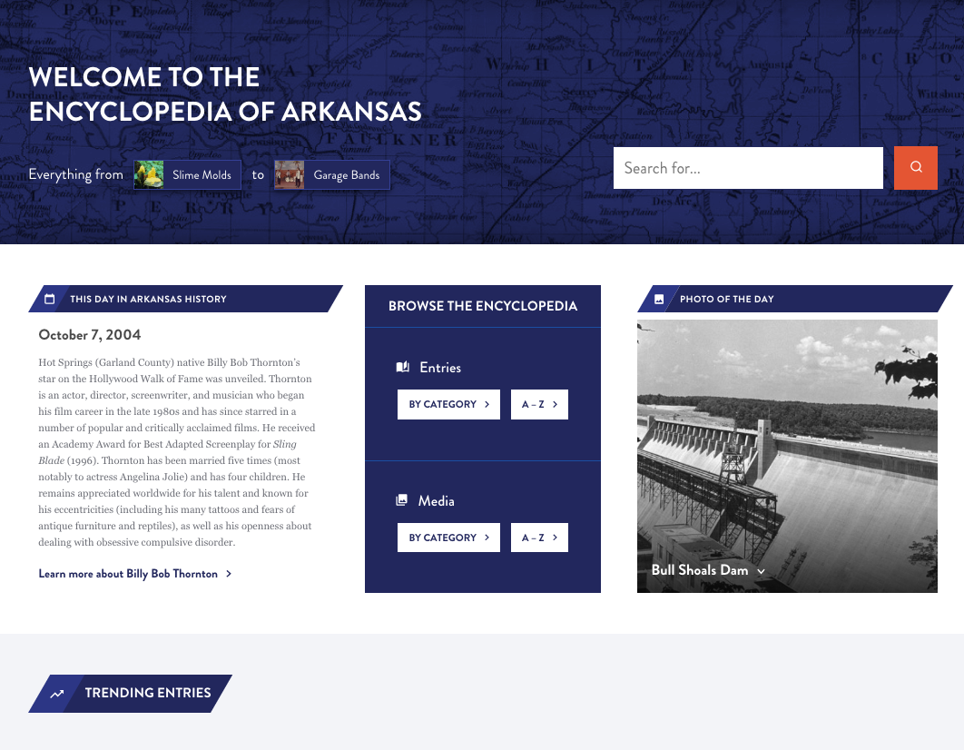
Notes:
The Encyclopedia of Arkansas launched in 2006 with 700 entries and 900 pieces of media.
In 2019 we switched platforms from the original proprietary site to a newly designed WordPress site.
And then in August 2022 we undertook a further redesign of the home page, search function and user experience features.
You can stop by the EOA for tidbits like THIS DAY IN ARKANSAS HISTORY and PHOTO OF THE DAY...
As well as trending entries and or to see what's been newly updated. (and here's a hint, we are updating all the time).

Slide 3
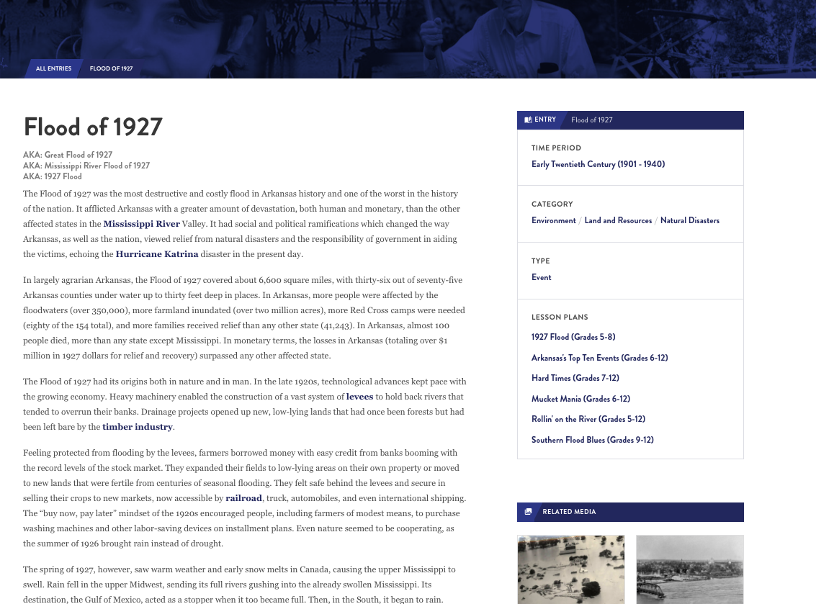
6,908
entries
Notes:
Almost 7000 entries
Often compared to Wikipedia
Peer reviewed and edit entries
Anyone can write for the EOA but all entries are reviewed by other scholars, fact checked and edited for grammar and spelling.

Slide 4
EVERY incorporated community
Government officials
Civil rights organizations from NAACP to CLOB
EVERY military action including the smallest skirmishes
Wildlife, flowers, plants
Notes:
WE HAVE ENTRIES ON ...
Every incorporated community, hundreds of unincorporated ones and always seeking more
ENTRIES ON
Government officials from those who served in Congress, to Arkansas constitutional officers, to individual state legislators, even significant sheriffs, mayors, and county judges
Civil rights organizations from the national level, such as the NAACP, to the local level, such as CLOB (Council for Liberation of Blacks)
Military events from the Civil War, ranging from major battles (Pea Ridge) down to small local skirmishes; if someone in blue and someone in grey meet in the woods between 1861 and 1865 we probably have an entry documenting it.
AND THE NATURAL ENVIRONMENT - birds, fish, mammals but also fungi, lichens, ferns, jellyfishes
AND WE ARE ALWAYS DEVELOPING MORE...
Developing entries on every film set or filmed in Arkansas, as well as every book, television show, and even individual episodes set in the state (Search: X-Files)

Slide 5
Produced by a public library
230 countries
EVERY continent
Notes:
Used by government agencies and officials, students, media, genealogists, historians (local and national)
Users have come from every continent (including Antarctica) and more than 230 countries.
Over 175,000 users per month

Slide 6
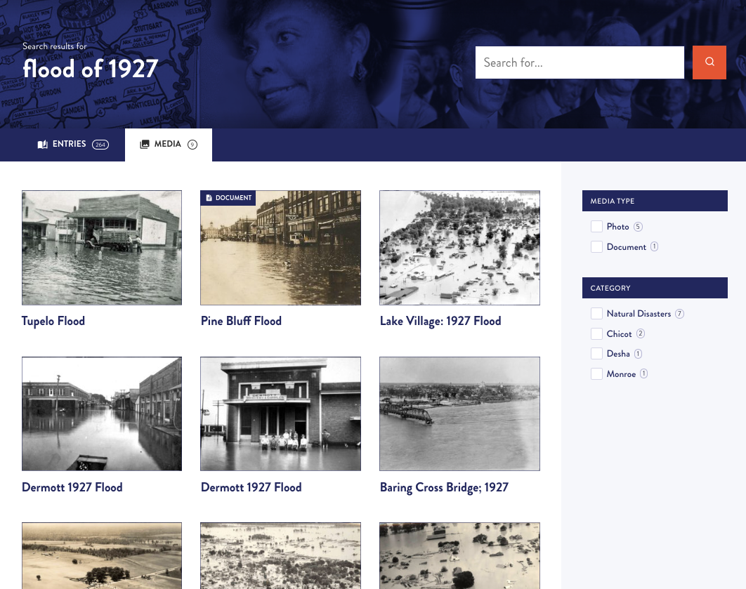
12,041
media
Notes:
AND DO WE HAVE MEDIA...
We have worked with archives, libraries, museums, and universities around the state and the country to make sure that the EOA has visual images to illustrate our entries.
BUT THERE IS ALWAYS MORE TO FIND...
We rely on everyday citizens to help us locate photos.

Slide 7
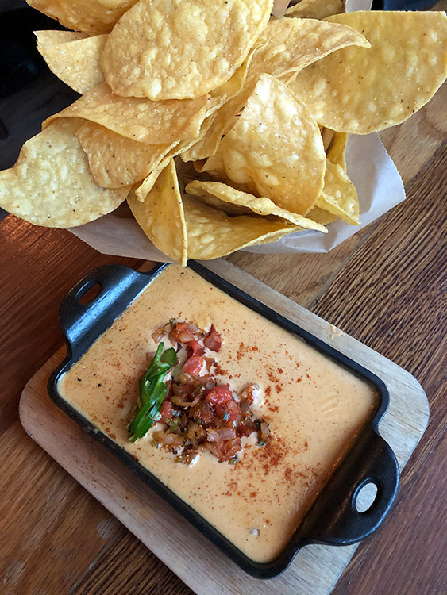
Notes:
NUMBER 1
Did you know cheese dip was invented in Arkansas?
It is believed that the original cheese dip was invented either in North Little Rock or Hot Springs.
Cheese dip connoisseur and scholar Nick Rogers, who has researched the history of cheese dip, traces the invention of the dish to Blackie Donnel, the original owner of the Mexico Chiquito restaurants. The restaurant chain was opened by Donnel and his wife in North Little Rock in 1935. Whether or not Donnel’s cheese dip was the first is hard to say, but his restaurant is indeed famous for its secret recipe.

Slide 8
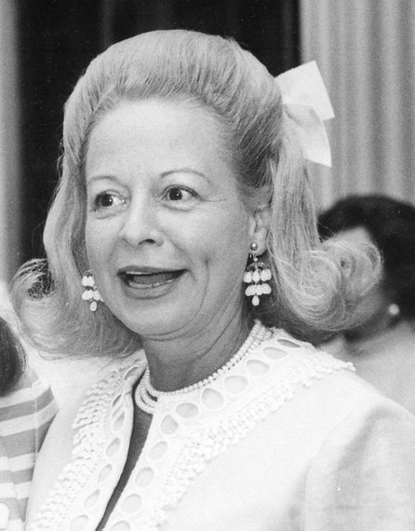
Notes:
NUMBER 2
Did you know an Arkansas woman brought down a president?
Martha Mitchell gained worldwide recognition for her outspokenness during the Watergate scandal. She was a renowned character in Washington DC. During Nixon’s first term, her husband, John Mitchell, was attorney general. Nixon once said, “If it hadn’t been for Martha Mitchell, there’d have been no Watergate.”
Mitchell famously got on her pink princess telephone and call reporters at all hours of the day to comment on particular issues, including relaying information about the Nixon administration’s corrupt activities.
Mitchell was born in Pine Bluff and is buried there. Her life has been dramatized in TWO plays AND most recently in the TV series Gaslit starring Julia Roberts as Mitchell. In June 2022, Netflix released the documentary The Martha Mitchell Effect.

Slide 9
Notes:
Most people know about Arkansas diamonds... but what about bromine.
Bromine is a highly corrosive, volatile element found in liquid form. Arkansas ranks first in the world in the production of bromine and it is one of the top three minerals produced in Arkansas.
Bromine is used in flame retardants, insect and fungus sprays, anti-knock compounds for leaded gasoline, disinfectants, photographic preparations and chemicals, solvents, water-treatment compounds, dyes, insulating foam, hair-care products, and oil well–drilling fluids.

Slide 10
Notes:
Arkansas is famous for the Little Rock Nine but what other civil rights activists has this state produced?
Leroy Eldridge Cleaver, born in Jefferson County, was one of the best-known and most recognizable symbols of African-American rebellion in the 1960s as a leader of the Black Panther Party.
Cleaver was wounded and arrested on April 6, 1968, in a Black Panther shootout with police. After a judge ordered him released from prison two months later, Cleaver undertook a series of lectures at the University of California at Berkeley and ran for president as the candidate of the Peace and Freedom Party.

Slide 11
Notes:
You might know that Arkansas is famous for our watermelons, pink tomatoes and purple hull peas but what about the apple?
In the late 19th century, apples became a dominant agricultural crop and an economic engine for the northwest part of the state. However, its importance declined measurably in the last half of the 20th century.
From a crop of over three million bushels in 1906 to record production of over five million bushels in 1919, production declined steadily to less than two million bushels in 1935 to crops of less than 250,000 bushels by the 1960s.

Slide 12
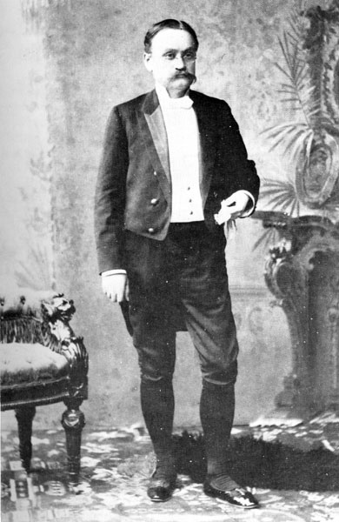
Notes:
We've produced a number of politicians and notable government officials but did you know that Arkansans were present at the wedding of Nicholas and Alexandra of Russia as well as their coronation in 1896?
Clifton Rodes Breckinridge served as Congressman from Arkansas between 1883 and 1894 and then was appointed Minister to Russia by President Cleveland.
When Breckinridge and his family arrived in Saint Petersburg in late 1894, Tsar Alexander III had just unexpectedly died. The American diplomat and his wife attended the wedding and coronation of Nicholas II. The court dress Katherine Breckinridge wore to the coronation is in the collection of the Old State House Museum in Little Rock

Slide 13
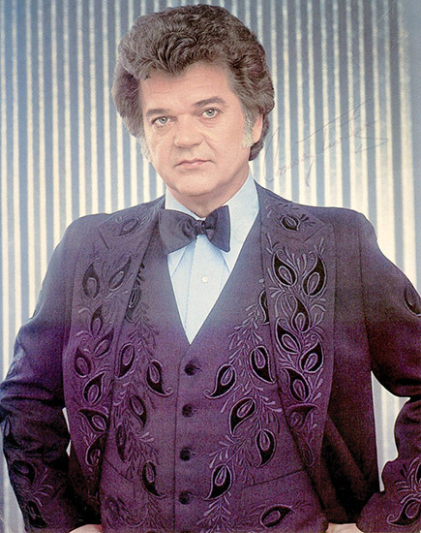
Notes:
Most people know that Johnny Cash was an Arkansan and loved his home state but there's a long list of musicians and singers in all genres hailing from the Natural State.
Harold Lloyd Jenkins, better known as Conway Twitty, grew up in Helena Arkansas. He took the first name of his stage name from Conway in Faulkner County. He would go on to record 110 albums, had more than (50) No 1 singles, won numerous Academy of Country Music and CMA awards as well as two Grammys. He was inducted into the Country Music Hall of Fame in 1999.

Slide 14
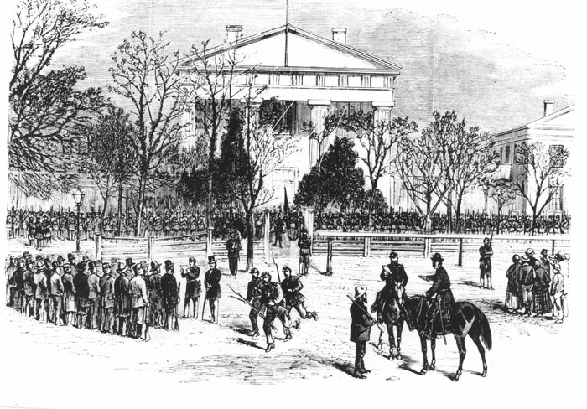
Notes:
And we've had our fair share of political drama and upheaval.
In the spring of 1874 an armed conflict between the supporters of two gubernatorial rivals—Joseph Brooks and Elisha Baxter -spilled out of Little Rock into much of the state. Known as the Brooks-Baxter War, the conflict was resolved only when the federal government intervened.

Slide 15
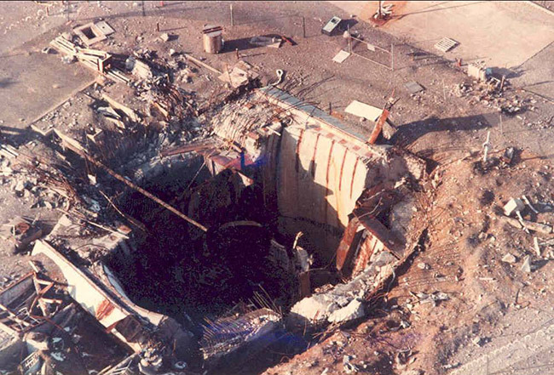
Notes:
We've also averted a nuclear disaster...
The Titan II Launch Complex 374-7 in Southside, just north of Damascus, became the site of the most highly publicized disaster in the history of the Titan II missile program when its missile exploded within the launch duct on September 19, 1980. An Air Force airman was killed, and the complex was destroyed.
The complex had already been the site of one significant accident two years before, when an oxidizer leak sent a cloud of toxic fumes 3,000 feet LONG, 300 feet WIDE, and 100 feet HIGH drifting across U.S. Highway 65.

Slide 16
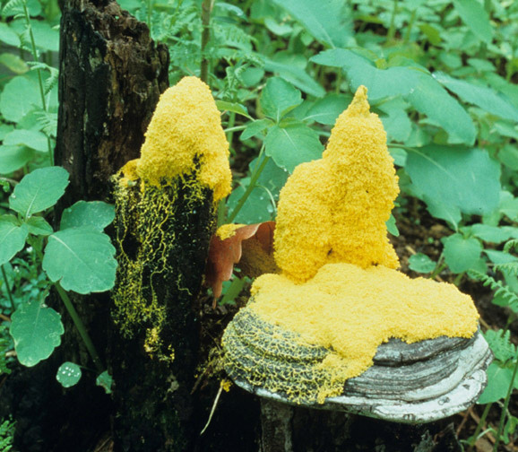
Notes:
We have many beautiful flora and fawna but some only a native can love...
Slime molds are among the more interesting yet relatively little known organisms found in Arkansas. They do not have a particularly attractive name, but some examples produce fruiting bodies that are miniature objects of considerable beauty.

Slide 17
QUESTIONS
Notes:
This is just the tip of the iceberg. The Encyclopedia of Arkansas is a rabbit hole I encourage you to jump down. No matter what you are interested, Arkansas has it and the EOA is where you can start looking.

